Slide 1
TORCH Conference
Fall 2023

Slide 2

Topics
Current Topics
  DPP Programs
  Charity
  Federal DSH & 340B
  RHC’s
Financial Insights
1115 Waiver Programmatic Issues
  LoFTS
  CHIRP
  RAPPS
Other Issues
Scan to get your copy NOW

Slide 3
Current Topics & Updates

Slide 4
DPP Programs

Slide 5

New Acronyms s
Programs are always changing
  TNIP – mentioned a couple of years ago.
  Federal law (42 C.F.R. § 438.6(b)) – Also knows as “B” programs, are managed care programs exempt from budget neutrality and actuarily soundness.
  5% of total Medicaid Spend or about $1.5B net of IGT.
  Now it is being called a Quality Incentive program
APC / EAPG – Outpatient PPS for Medicaid
  State is taking traditional Medicaid
  Using B programs to incentivize moving to APC/ EAPG
Notes:
TX Network Improvement Program- what the rule is %5 can be done through the managed care programs….incentive/quality whatever they want to develop. It’s new money.
Get hospitals to accept and enhance APG
To target rural
Pay for performance/quality……managed care can do a lot of other things if they want to show it
Taking traditional XIX to incentive programs

Slide 6
DPP Program Growths
Going back to Private UPL
  Which was forecasted to be about $500M
DSRIP / UCC
  Program grew to $6B per year
Today $12B
Estimated 2025
  HHSC - $16B
  CHAT – $20B

Slide 7
State DPP Summary
 | Class Count | UC Pmts | DSH Pmts | UHRIP Pmts | ACIA Pmts | Total
Children's | 10 | $116,924,509 | $23,133,508 | $1,036,654,319 | $634,185,455 | $1,811,000,000
Non-Rural Public | 8 | $123,614,217 | $87,957,190 | $61,125,545 | $19,769,902 | $292,000,000
Private IMD | 29 | $1,269,209 | $30,539,546 | $17,850,122 | $752,070 | $50,000,000
Rural | 155 | $412,956,925 | $197,853,005 | $102,914,194 | $132,344,165 | $846,000,000
State | 18 | $175,148,351 | $358,569,123 | $87,936,754 | $20,127,987 | $642,000,000
Urban Private | 158 | $1,790,180,922 | $527,191,649 | $2,418,134,622 | $1,150,672,578 | $5,886,000,000
Urban Public | 5 | $1,818,021,143 | $881,942,653 | $341,501,244 | $68,577,419 | $3,110,000,000
Grand Total | 383 | $4,438,115,275 | $2,107,186,674 | $4,066,116,800 | $2,026,429,577 | $12,638,000,000
Notes:
This is the spend by programs….notice the children’s program for 10 hospitals….they are the winners in UHRIP.ACIA
They are battling to keep the CHIRP payments.
Rural hardly gets any….155 hospitals split

Slide 8
Program Changes
HHSC is wanting to shift dollars from ACIA to preserve UC.
  Rural effect is a loss of $42M net.
Why?
  CHIRP (w/ ACIA) is taking a large portion of the total budget neutrality
  To be neutral we would have to reduce UC
  UC is being rebased – and has the potential to grow
  UC is seen as a fairer program
    ACIA benefits the hospitals with better managed care contracts
    The rich get richer, and the poor….
  UC also has a better IGT to benefit timing
  Does any rural really care for CHIRP?
So what's the issue?
Notes:
Targeted program to give rural their full UC. From policy standpoint takes hospitals with great contracts and give them huge bonuses. Bad contracts, you don’t get ACIA. Rich get richer and poor get poorer. Reduce ACIA to grow UC….this is what they are wanting to do.
CHIRP takes 6 months to a year to get money.
Data is incorrect, none of the claims are correct……creted an eat what you kill. Rural protections are being geared towards pay 4 quality.

Slide 9
Program Changes, Continued
Certain hospitals have a large gain in CHIRP
  Childrens
  Large dominant urbans
Their claims
  HHSC model has serious flaws
  CHAT and other studies show that HHSC data is materially incorrect.
Truth
  HHSC’s estimates are probably conservative
  Still does not address in inequity of the ACIA incentive
  ACIA could have been better shared, rather than provider specific….

Slide 10
Program Changes, Continued
Possible protections for rural are based on new “B” programs – P4Q
  The P4Q like all programs require substantial IGT’s
  There is a push to NOT have this be 6 months or more out.
The incentives will change over time, as once the APC/EAPG is adopted, CMS will require a new incentive.
  These programs never get easier
  For rural we really need something for network adequacy
    Like DSRIP for specific programs and access
    Something that is stable and consistent
We really need ideas and data to support this.
  Aging Medical staff?
  Other barriers.
  Wish we could do something for CAH / REH make whole payments.
Notes:
Need something geared towards access to care. State of TX doesn’t really think that way. They love the buzz words, but need something to give rural stability. Bundled rates always mean less payments.

Slide 11
APC/EAPG
Outpatient changes will have serious reductions to rural, unless they somehow protect rural populations.
Bundled rates usually always means less payment.
EAPG in other states has resulted in lower Medicaid spending.
It is not clear how they will design a rural protection in the proposal.
Protections in a base year, do not account for the variable rural outpatient utilization.
  Rural is just not consistant
Notes:
3 years from now…..what does that mean….what data is still going to be available and needed. We are going to get the EAPG’s and what is the long term survival rate of that money? Something to think about and pay attention to.

Slide 12
CHARITY

Slide 13
Charity Updates
  HHSC is pursuing an 1115 Waiver amendment to allow the UC pool to be resized based on 2025 data
    This means we can take steps to maximize the UC pool size
      Increased FPL in charity policies
      Catastrophic Language
      Write off all services and charges with the exception of professional fees & ambulance (we’ve already made this adjustment in the Clearfork Data Platform for hosted clients)
  Charity Policy must be approved by the board each year – new audit requirement.

Slide 14
Common Mistakes Seen with Charity
Business office needs to know the importance & the how
Charges must be brought back to GROSS
  Any adjustments reversed → this includes Bad Debt
  Any discounts reversed
  Payments are net
  Account must then be written off by FYE --- or does it?
    Consistent & Constant Review of Charity is a must
    Don’t wait until end of fiscal year due to the weighting mechanism at UC Audit
UC Application completed based on FYE data
UC Audit based on Federal FYE (Oct – Sept)

Slide 15
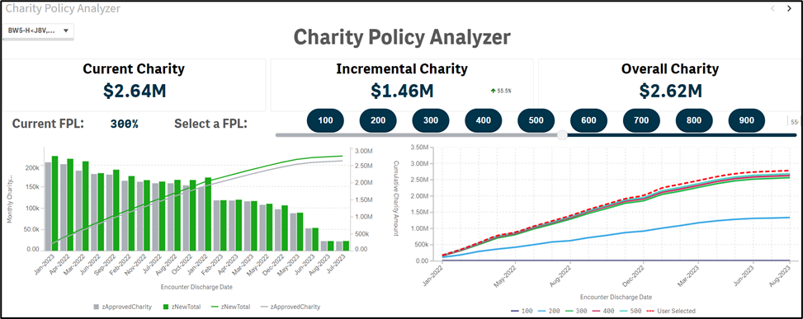
Tools to Help - Charity Policy Analyzer
#1 Select an FPL
#2 See Incremental and New Total Charity
#3 See sensitivity at various levels

Slide 16
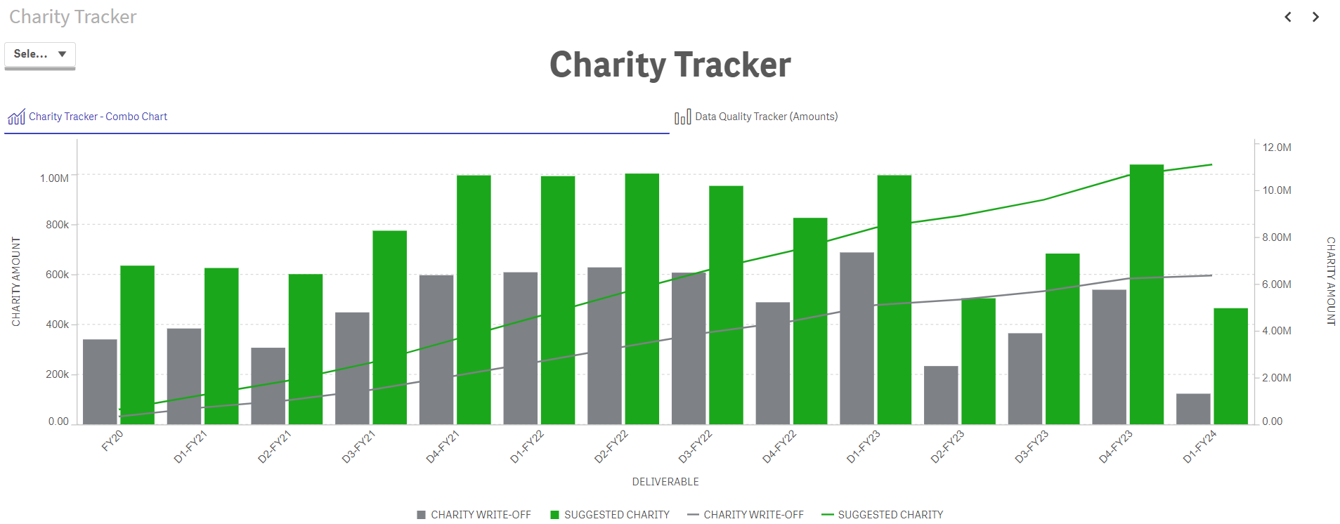
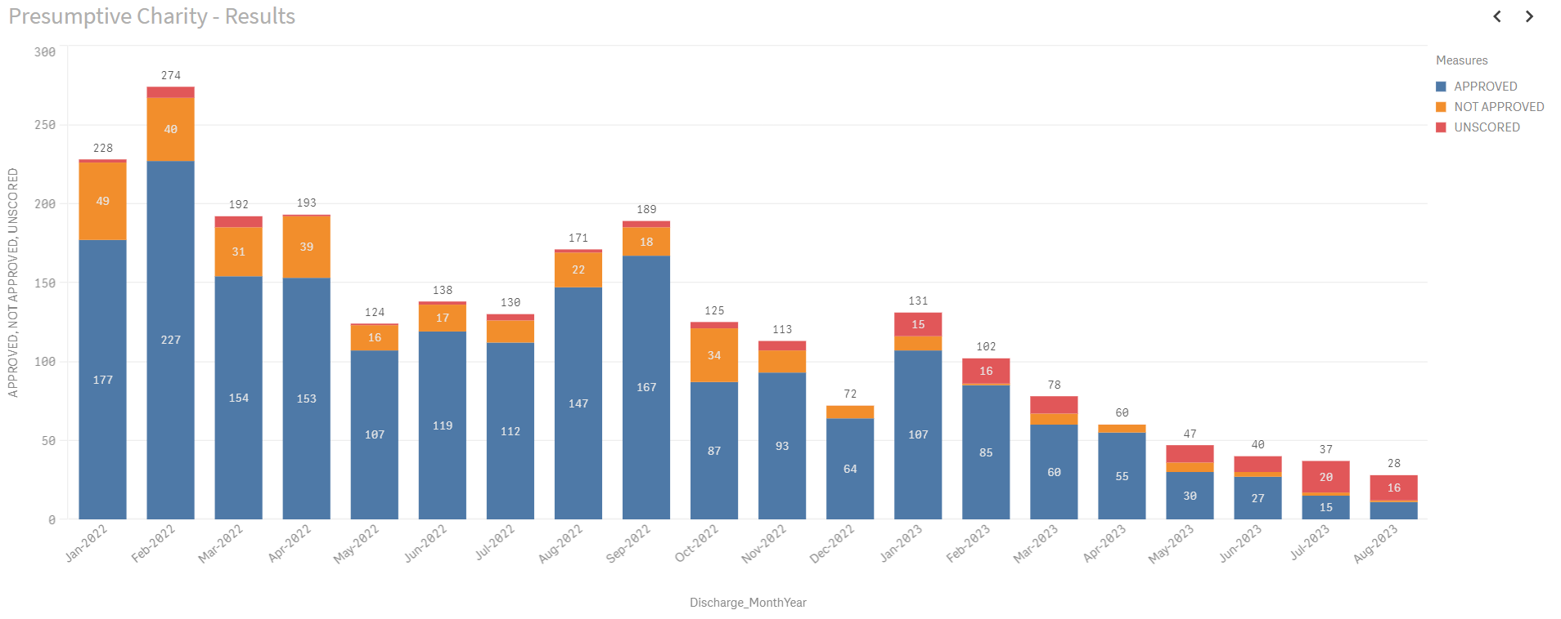
Tools to Help – Charity Tracker
#1 See Approved vs. Written-off Charity amounts
#2 Make sure Write-offs are on-time for key reporting milestones
#3 Review total record and approval trends

Slide 17
Data is the Key!
Cost report
Data acquisition & analytics
Charity Report
S-10 Audits/DSH/UC application/Claims analysis etc

Slide 18
Worksheet S-10 Revisions
Two New Required Templates for Charity and Bad Debt
  Exhibit 3B – Charity Care Charges
  Exhibit 3C – Total Bad Debt Charges
Must be submitted with Cost Reports beginning on or after 10/1/22
Reconciliations at the encounter level, year over year
  All hospitals eligible for DSH and UC must complete both
  Each CMS Certification Number (CCN), a separate exhibit for both charity and bad debt must be completed

Slide 19
Worksheet S-10 Revisions
S-10 will have a Part 1 and Part II
  Part 1 is for the entire hospital complex (current S-10)
  Part II is the IP and OP services excluding data from any other part of the hospital (ie. SNF, HHA, Hospice, ESRD, etc)
    Will this new part II be used in future rulemaking to calculate UC?
Three Categories to Consider:
  Uninsured
  Insured but not covered (ie. exhausted benefits, noncoverage)
    Where is this in your S-10…..Insured or Uninsured?
      Should be Uninsured to maximize UC
  Insured

Slide 20
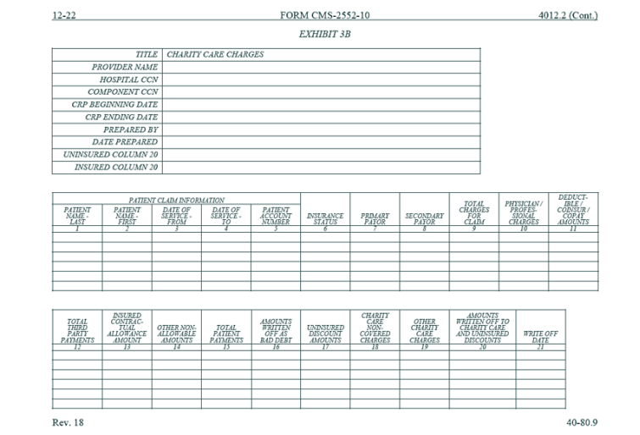
Exhibit 3B – Charity Care Charges

Slide 21
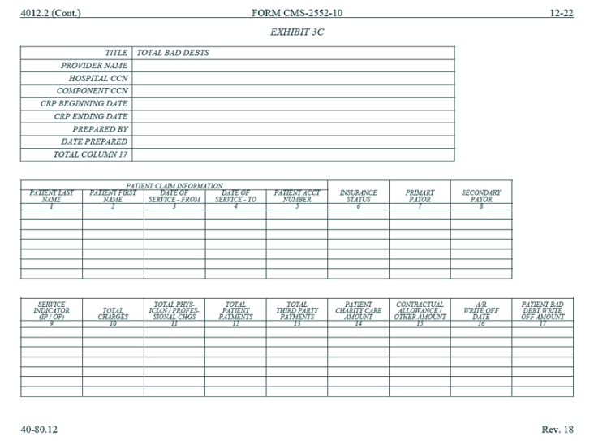
Exhibit 3C – Total Bad Debt Charges

Slide 22
Changes to DSH 2024 Qualification for Advance DSH payments-LIUR
Some hospitals only qualify for DSH payments based on LIUR and have been kicked out of DSH for 2024
PY DSH, 37 hospitals qualified only on LIUR compared to 18 on 2024 DSH Advance payment file.

Slide 23
Federal DSH & 340B

Slide 24
Disproportionate Share Hospitals & 340B Qualification
DSH Qualifying hospitals must have an 11.75% DSH ratio for the most recent cost reporting period ending before the calendar quarter involved.
Sole Community and Rural Referral Centers qualify with an 8% DSH ratio.
Federal DSH is made up of two factors.
  SSI %-SSA Data
  Medicaid utilization %-Hospital Data
    1115 waiver days are currently included in Medicaid %.
    Effective for discharges 10/1/2023 and after, 1115 waiver days will not be allowed to be added to Eligible Medicaid Days-CMS finalized 2024 IPPS rule.
Rural stratification and the Orphan Drug discount eligibility -
Notes:
Brent

Slide 25
Disproportionate Share Hospitals & 340B Qualification – HRSA Enforcement
HRSA has increased the review and enforcement of the qualifications for 340B through the DSH %.
HRSA has issued several interpretive FAQs (website) on qualifications, and they are enforcing these interpretations.
    HRSA has become astute to rural impact of decreasing L&D
Take away: Ensure that you have claimed all eligible Medicaid days for DSH and ensure that the total days are accurate during initial reporting.
Notes:
Brent

Slide 26
Pharma fights back
Big pharma is fighting 340B
  Supreme Court June 2022 ruling was a win for hospitals over CMS
The fight continues
  3rd Circuit opinion limiting contract pharmacies is a win for Pharma
This fight will continue.
  340B is a flawed program as it does not actually help consumers, according to much of the data
  Pharma however is not helping consumers either
  PBM’s are flawed, as they chase the “rebates” i.e. ……
Has anybody looked at Mark Cuban’s Drug Program?
Notes:
Cuban is really after the PBM’s…..nothing more than a kickback. They let the insurance pay and play.

Slide 27
RHC’s

Slide 28
XIX Change of Scope: What is It?
RHCs are paid by Medicaid based on their encounter rate
    Encounter rate is updated each year based on the MEI (Medicare economic index)
Original base year was set from 1999/2000 cost report
    20 plus years since the last base year was completed
A change in scope of services provided by an RHC include
    The addition or deletion of a service
    A change in the magnitude, intensity, or character of services currently offered at the RHC.
Notes:
BF and SC

Slide 29
XIX Change of Scope: When to Request?
RHC can request a Medicaid change of scope if one of the 6 applies to them
    1. An increase in a specific patient type/service (example- Covid)
    2. Change in services provided
    3. Changes in operating costs attributable to changes in capital expenditures (new service facilities)
    4. Changes in operating costs attributable to changes in technology
    5. Indirect medical education adjustment (reflects costs of providing teaching to interns and residents)
    6. Any other change in scope approved by Health Resources and Service Admin (HRSA), although change of scope is administered at state level.
Notes:
BF and SC

Slide 30
Financial Insights

Slide 31
Operations
We tend to focus on all the “bonus” payments rather than actual operations.
  We need to not lose sight of the basic blocking and tackling of operations
Cost containment
New patient services
Market analysis
Notes:
What works for business doesn’t really work in healthcare

Slide 32
Tools to Help – Financial Insights
Move from Insight to Action quicker than ever before
  Crunch bigger datasets
  Visualizations that make finding Insight easier
  Drill-through to source system and record in seconds
Works across all your systems
Helps move beyond EMR vendor limitations on analytics and reporting
Enriched with third party datasets (ex. MMIS, Definitive Healthcare, HCRIS,…)
Built on Clearfork Data Platform with Discovery Subject Matter Expertise
Notes:
We have the data leakage and can speak in to this

Slide 33
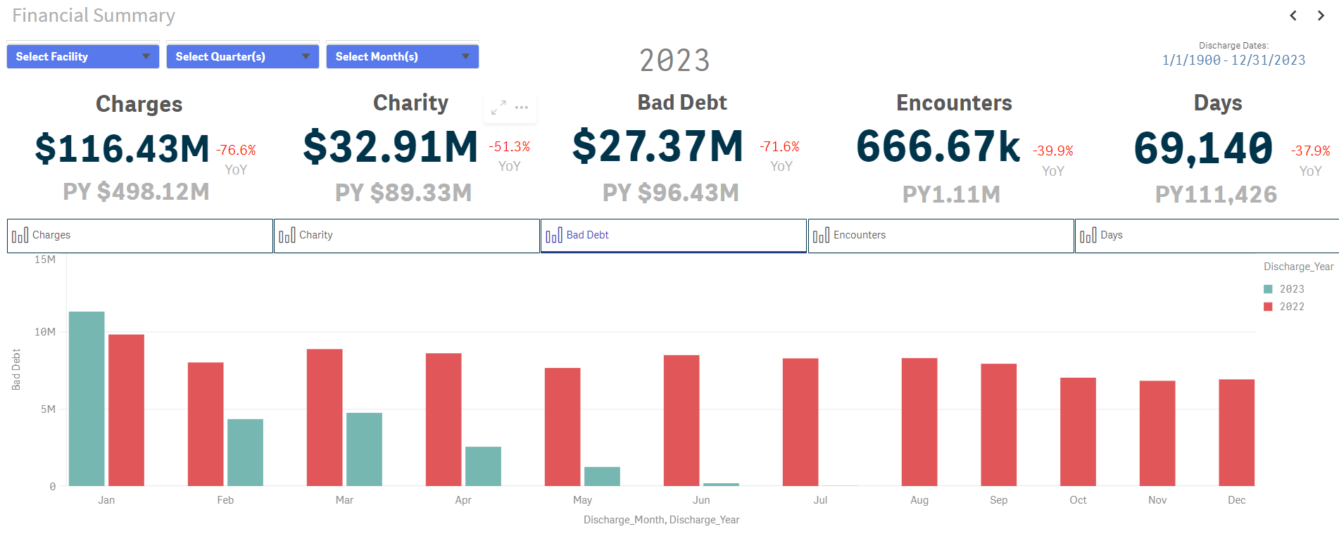
Leadership Insights – Financial Insights Package

Slide 34
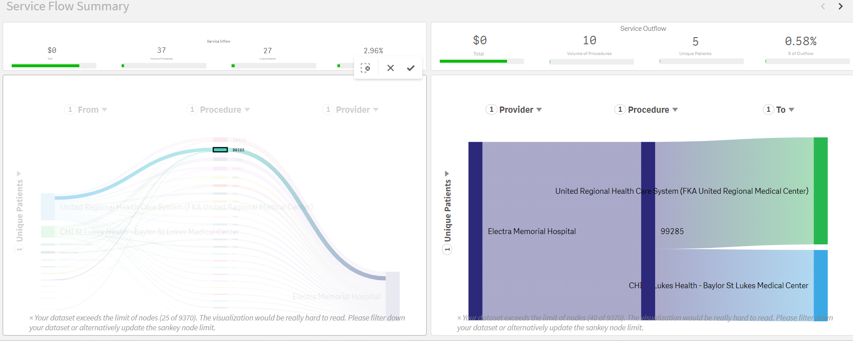
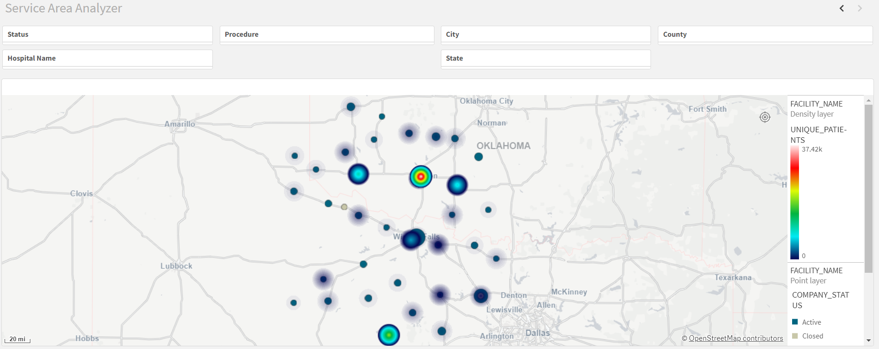
Leadership Insights – Service Analytics
#1 Know volume of procedures and unique patients, along with total charges using multiple facilities within a specified timeframe
#2 Understand what and where by procedure code to make key decisions

Slide 35

LoFTS

Slide 36
Local Funds Tracking System (LoFTS)
Reporting is Now Yearly for ALL Modules.
  Reporting Window October 1-31, 2023 (Same as DPP Reporting)
  Report on IGT and Revenue for FFY23 (October 1, 2022- September 30, 2023)
Mandatory Training
  Module 1- LPPFs Only
  Modules 2 and 3- All NSGO (Governmental Hospitals) NOT in an LPPF
    Wednesday, September 27, 2023 10-11 AM
  Module 4- SHARS
    Monday, September 25, 2023 10-11 AM OR Thursday, September 28, 2023 10-11AM
    TEAMS Meeting Link https://pfd.hhs.texas.gov/local-funds-monitoring or by Phone # (512) 580-4366; Conference ID 536 135 976#
  Module 4- LGEs Who Submit CPEs for UC Ambulance or PHP-CCP
    Thursday, September 28, 2023 2-3 PM
    TEAMS Meeting Link https://pfd.hhs.texas.gov/local-funds-monitoring or by Phone # (512) 580-4366; Conference ID 662 265 241#
LoFTS Team PFD_LFM@hhs.Texas.gov
Notes:
Reporting window announced on mandatory training email. The link to reporting will be on the LoFTS website.
SHARS- School Health & Related Services
CPE- Certified Public Expense
Ambulance Services Supplemental Payment Program (UC Ambulance)
PHP-CCP- Charity Care Program for GEs (Public Health Provider- Charity Care Program)
Reporting user guides are available on the Local Funds Monitoring website and we are available to help as well.

Slide 37
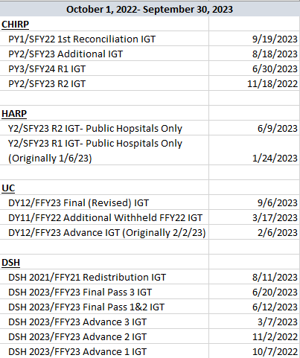
Local Funds Tracking System (LoFTS)
IGT Settlement Dates Module 2- Hospital Programs
Notes:
This isn’t to read over- this is for providers to take with them to use when they complete IGT reporting to make it easier for them to find their IGT amounts for CHIRP, HARP, UC, and DSH.

Slide 38
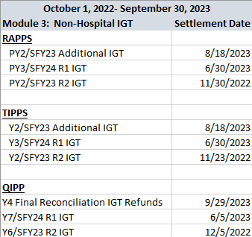
Local Funds Tracking System (LoFTS)
IGT Settlement Dates Module 3- Non-Hospital Programs
Notes:
This isn’t to read over- this is for providers to take with them to use when they complete IGT reporting to make it easier for them to find their IGT amounts for RAPPS, TIPPS, & QIPP.

Slide 39
LoFTS Risk
Are Borrowed Funds eligible for IGT
Is patient Revenue (non-Medicare & Medicaid) a source for IGT
  What about State share of Medicaid
How long until “funds” become a reserve
How do you assign labels to dollars
Unfortunately, CMS is the Judge & Jury
  Will the A&G sue on this issue? Like they did for LPPF?
Notes:
We don’t know these answers…..A&G sued and won….is there enough power for them to sue, doubtful. We are concerned and we haven’t see how this is going to be used yet.

Slide 40
MJ-LPPF
The first one has been established in East Texas
HHSC has asked CMS for approval
That’s going to be tricky
  Will the A&G sue on this issue? Like they did for LPPF?
We have another MJ LPPF we are filing for, to get approval
This could provide an alternative for those providers out of IGT
Notes:
We have worked with 2 and HHSC has taken these to the feds for their blessing and we are in a wait for this. This is great for nursing home guys and governmentals that need more IGT. It’s more compliant than all of the loss collections (?)

Slide 41
CHIRP REPORTING

Slide 42
CHIRP Y3 R1 Reporting Changes
Reporting Due October 31st
Component 1 (UHRIP) Reporting
  Removed Learning Collaborative Participation
  Updated Health Information Exchange (HIE) Participation
    Still Structure Measure; No Right or Wrong Answers
    New Questions
      Separating participation in HIE vs EHR with HIE capabilities
      Who do you share with– hospitals, non-hospital providers, MCOs?
      Types of data shared
    Only Report R1
  Added Non-Medical Drivers of Health (NMDOH) Screening
    Structure Measure; No Right or Wrong Answers
    Screening for Food Insecurity, Housing, & Transportation Needs
    Report on Screening Instruments, Questions, Follow-Up Plans
Notes:
For this round, Health Information Exchange questions have changed from a more vague do you have the capability to connect to an HIE (and which ones) to do you actively send and receive data; they want to know if you do more than have an EHR that has HIE capabilities. If you share data, who is it shared with: hospitals, other non-hospital providers, MCOs. What type of Data are you sharing: Admissions, Discharges, and Transfer (ADT) data, Consolidated-Clinical Document Architecture (C-CDA) data, Fast Healthcare Interoperability Resources (FHIR) standard data?

Slide 43
CHIRP Y3 R1 Reporting Changes
Reporting Due October 31st
Component 1 (UHRIP) Reporting- Continued
  No Changes to Medication Reconciliation: # of Unintentional Med Discrepancies per
  Patient (All Payer)
    Still Just Reporting Data; No Pay for Performance
    Measurement Period for Round1 Reporting is 1/1/23- 6/30/23
    Measure Overview
      Pull rolling sample of inpatients throughout the measurement period (1-2 per week)
      Certified pharmacy technician, pharmacist, or pharmacy resident must interview patients within 24 hours of admission (over and above standard intake interview, even if pharmacy staff does your standard intake interview)
      Then a pharmacist does a review after discharge, using a standardized process.
    If NOT implemented, still allowed to report 0/0.
    Verify LeapFrog Reporting
      https://ratings.leapfroggroup.org/
    If implemented but have fewer than the 38 minimum interviews, submit all you have completed.
Notes:
IF your pharmacy staff already does your intake interview, you would still have to have a different person come in as a more thorough check of your processes, but that person can be from the same staff.
0/0 can be reported for this measure because if someone is discharged before they can be interviewed, they are excluded from the denominator.
Discuss LeapFrog reporting and differences (LeapFrog is only patients 18 and older in 2 units of the hospital; this measure is ALL ages, all units.
38 is the 6-month minimum; 76 is the 12-month minimum.

Slide 44
CHIRP Y3 R1 Reporting Changes
Reporting Due October 31st
Component 2 (ACIA Rural) Reporting
  Removed Influenza Immunization (Kept in RAPPS)
  Added Depression Screening
    Process Measure; Reporting Data but NOT Pay for Performance
    Measurement Period for Round1 Reporting is 1/1/23- 6/30/23
    Measure Overview
      Denominator= Patients aged 12 years+ at beginning of measurement period
      Exclusions/Exceptions: Patients with past depression or bipolar disorder diagnosis, patient refusals, patients with documentation of medical reason not to screen
      Numerator= Patients who screened negative for depression (on date of encounter or up to 14 days prior) using an age-appropriate standardized tool AND patients who screened positive with a documented follow-up plan on date of encounter or up to 2 days after encounter.
Notes:
There is a list of tools in the measure specification, but you can also include “Other” and specify.

Slide 45
CHIRP Y3 R1 Reporting Changes
Reporting Due October 31st
Component 2 (ACIA Rural) Reporting- Continued
  3. Updated Tobacco Use: Screening & Cessation Intervention
    Exclusion for documentation of medical reason not to screen is now gone. Only exclusion now is hospice.
    For Y3 consider e-cigarettes and other electronic nicotine delivery systems to be tobacco use.
    Counseling or pharmacotherapy can now occur up to 6 months prior to the measurement period (7/1/22- 6/30/2023).

Slide 46
CHIRP Reporting- Anticipated for Year 4
Component 1 Reporting
  Medication Reconciliation: # of Unintentional Med Discrepancies per Patient
    This process may need to be in place for Year 4 as a condition of participation.
      Year 4 reporting based on data for CY2024; process needs to be in place by January 2024.
      Rolling sample throughout the CY
      Currently, sampling is NOT a % of admissions, but that MAY change; the rate of 1-2 patients per week may increase for larger-volume hospitals
      If Pay-for Performance is in place for Y4, goals are TBD. Current performance targets are posted on the bulletin board of the reporting portal.
    What if we don’t have the staff?
      HHSC has said to consider contracting.
      Initial interview by a pharmacy technician, pharmacist, or pharmacy resident can be done virtually
      Pharmacist can do post-discharge review remotely
Notes:
Rolling sample throughout the year– cannot wait until the end of the year to sample patients
Rural Emergency Hospitals (REHs) don’t have inpatients, so obviously something would have to be done to accommodate REHs, but that has not been determined yet.
Goal Structure could be similar to DSRIP, where some measures were IOS (Improvement Over Self) and some were QISMC (Quality Improvement System for Managed Care) where providers work towards gap closure to a set goal, with a MPL (Minimum Performance Level)
Initial interview is required within 24 hours of admission, but this may be done virtually.
SO WHEN WILL WE KNOW???

Slide 47
CHIRP Reporting- Anticipated for Year 4
Component 1 Reporting- Continued
  HHSC Intends to Have Measures Decided by December 2023.
    BEFORE February Enrollment & Private Hospital Application Fee
  Additional Measure Changes TBD
Component 2 Reporting
  Measures Changes TBD
  Pay for Performance Strongly Hinted for Y4
    Any Process/Outcome Measures would report on data for CY2024; Processes would need to be in place by January 2024.
  Goal Structure TBD
    IOS from Baseline OR Gap Closure Towards Set Goal with MPL
Notes:
There is a workgroup made up of stakeholders working with HHSC to determine measure changes for Y4 (changing out measures, changing specifications, etc.).
Goal Structure could be similar to DSRIP, where some measures were IOS (Improvement Over Self) from a determined baseline and some were QISMC (Quality Improvement System for Managed Care) where providers work towards gap closure to a set goal, with a MPL (Minimum Performance Level)

Slide 48
RAPPS REPORTING

Slide 49
RAPPS Y3 R1 Reporting Changes
Reporting Due October 31st
Component 1 Reporting
  Removed ALL 3 Previous Measures
    Care Coordination
    Telemedicine/Telehealth Capabilities
    Electronic Health Record (E.H.R.) Use
  Added Non-Medical Drivers of Health (NMDOH) Screening
    Structure Measure; No Right or Wrong Answer
    Also in CHIRP
    Report on Screening Instruments, Questions, and Follow-Up Practices
Notes:
Component 1 (dollar increase on PMPM paid by MCOs)

Slide 50
RAPPS Y3 R1 Reporting Changes
Reporting Due October 31st
Component 1 Reporting- Continued
  3. Added HIE Participation
    Structure Measure; No Right or Wrong Answer
    Also in CHIRP
    Report on HIE connectivity, how you are using the HIE, who you are sending data to, and type of data sent
  4. Added Depression Screening
    Structure Measure; No Right or Wrong Answer
    Also in CHIRP as a Process Measure, but NO data reported for RAPPS
    Report on depression screening and follow-up practices
Notes:
Component 1 (dollar increase on PMPM paid by MCOs)
As with CHIRP, the Health Information Exchange questions are designed to determine if you actively send and receive data; they want to know if you do more than have an EHR that has HIE capabilities. If you share data, who is it shared with: hospitals, other non-hospital providers, MCOs. What type of Data are you sharing: Admissions, Discharges, and Transfer (ADT) data, Consolidated-Clinical Document Architecture (C-CDA) data, Fast Healthcare Interoperability Resources (FHIR) standard data?

Slide 51
RAPPS Y3 R1 Reporting Changes
Reporting Due October 31st
Component 2 Reporting
  Removed A1c Poor Control (>9.0%)
  Added Controlling High Blood Pressure
    Process measure so data is reported; No Pay for Performance
    Measurement Period for Round1 Reporting is 1/1/23- 6/30/23
    Measure Overview
      Denominator= Patients aged 18-85 at END of 12-month measurement period WITH Dx of hypertension during 1st 6 months of measurement period (Several Exclusions)
      Numerator= Patients whose most recent BP systolic <140 AND diastolic <90 (NO IP or ED readings)
      If no BP recorded during the measurement period, BP is presumed NOT controlled (Not Met for numerator inclusion)
      BP readings by remote monitoring device allowed
Notes:
Component 2 (% increase on specific services)
Controlling High BP Exclusions: ESRD, dialysis or renal transplant, pregnancy, hospice, palliative care, advanced illness, nursing home patients, 81 and older with frailty

Slide 52
RAPPS Y3 R1 Reporting Changes
Reporting Due October 31st
Component 2 Reporting- Continued
  3. Updated Influenza Immunization Measure
    Timeline has changed.
      Denominator= Patients 6 months and older seen for a visit between October 1, 2022- March 31, 2023.
      Numerator= Patients who received a flu shot between July 1, 2022- June 30, 2023.
      This means you will report the SAME DATA for R1 and R2, unless you need to make a correction or change your data pulling methodology.
    Exclusions are anaphylaxis due to the vaccine and hospice.
      No exclusions for patient refusal or vaccine not available.
    Self-reporting of shots received elsewhere IS still allowed.
      No specific documentation or coding requirements
Notes:
Component 2 (% increase on specific services)

Slide 53
RAPPS Reporting- Anticipated for Year 4
Component 1 Reporting
  Measure Changes TBD
  There may be processes that MUST be in place for Year 4 as a condition of participation.
  HHSC intends to have measures decided by December 2023.
Component 2 Reporting
  Measures Changes TBD
  Pay for Performance has Been Strongly Hinted for Y4
    Any Process/Outcome Measures would report on data for CY2024; Processes would need to be in place by January 2024.
  Goal Structure TBD
    IOS from Baseline OR Gap Closure Towards Set Goal with MPL
Notes:
We don’t know if Component 1 will remain all structure measures, where processes are NOT required to be in place and no actual patient data is required.
As with CHIRP process and outcome measures, the Goal Structure could be similar to DSRIP, where some measures were IOS (Improvement Over Self) from a determined baseline and some were QISMC (Quality Improvement System for Managed Care) where providers work towards gap closure to a set goal, with a MPL (Minimum Performance Level)

Slide 54
CHIRP & RAPPS Key Dates
October 4, 2023 - DPP Reporting Webinar by HHSC at 2PM
                Registration (gotowebinar.com)
October 31, 2023 - DPP PY3 Round 1 Reporting Due to HHSC
November 17, 2023 - CHIRP PY3 Round 2 IGT Settlement Date
November 30, 2023 - RAPPS PY3 Round 2 IGT Settlement Date
December 2023 - PY4 Requirements Announced
Notes:
If you can’t make the Reporting Webinar, HHSC will be posting at least the slides to the portal the following day, October 5th.
IGT Settlement Dates are HHSC’s Estimated Dates and are subject to change.

Slide 55
Summary of PY4 Changes
What We Know
  Changes ARE coming for PY4.
  A workgroup is in place to help HHSC set program requirements that CMS will approve.
  Measures and requirements will be determined by December 2023, before the February DPP application window.
What We Don’t Know
  What the changes will look like
    New Measures
    Pay for Performance versus Pay for Reporting
    Goal Structure (IOS or Gap Closure with MPL)
What We Think Will Happen
  Gold Standard Med Rec Process in place as a condition of CHIRP participation
  Pay for Performance

Slide 56
Have Questions? Need Reporting Help?
Contact me at:
Sherri Powell
sherrip@dhcg.com
806-370-3811

Slide 57
Other Current Issues

Slide 58
Increased Focused on Audit(s)
In recent months, we have seen a higher focus and more detailed documentation toward audits and reviews in many areas….
  This increased effort on audits seems to be across multiple regulatory agencies –
  More detailed Medicare Desk Audits
  More detailed questions and request for information in Medicaid state reporting and National Medicaid Redeterminations
  Medicare Bad Debt reviews
  Charity and UC reporting audits
  Price Transparency
  Lots of recent focus on Employee Retention Credits (ERC)
  HRSA review of 340B qualifications
Notes:
Brent

Slide 59
Rural Emergency Hospitals (REH) Update
Fewer Conversions than Congress would have anticipated
  A total of 7 hospitals have converted from previous certification to REH
    Of a total approx. 1,700 rural hospitals that are eligible for conversion
    5 of the 7 REH conversions are in Texas
    TX - 2 previously certified CAH and 3 previously certified PPS hospitals
Considerations of those that have converted
  Less payment on the OP side than anticipated
  Delays in processing state licensing for REH
  Slow processing of facility payment
  Will Facility payment and volume cover cost of operations
Notes:
Brent

Slide 60
Price Transparency: Proposed Changes
Attestation will be required to affirm accuracy and completeness
CMS issuing a template for standard charge information, will be required
Additional data elements will be required (and significant)
  “…whether the payer-specific standard charge listed should be interpreted by the user as a dollar amount, percentage, or, if the standard charge is based on an algorithm, the algorithm that determines the dollar amount for the item or service.”
  “…a consumer-friendly expected allowed amount…which would be the amount, on average, that the hospital estimates it will be paid for the item or service based on the contract with the third-party payer”
  “…a general description of the item/service, billing class (for example, whether the standard charge is billed as a facility or professional service), the hospital setting in which the item or service is provided (for example, in the inpatient or outpatient setting), drug-specific information such as the drug unit and type of measurement (such as number of milligrams), and information related to corresponding codes (such as common billing codes, revenue center codes, modifiers)”
  If finalized, compliance is mandatory by March 1, 2024

Slide 61
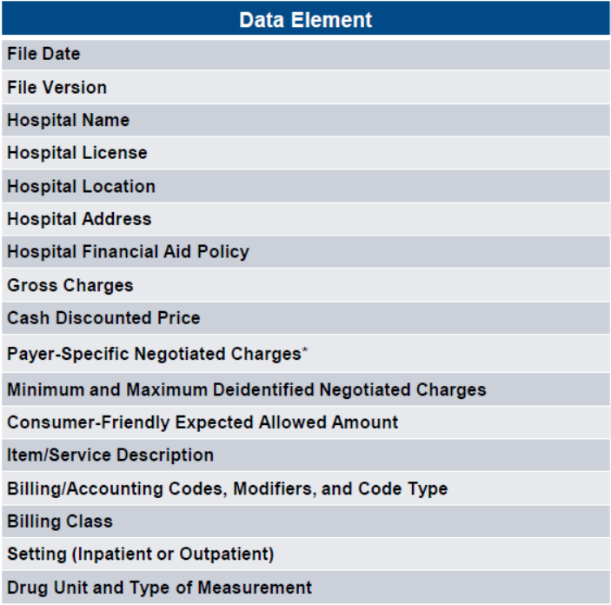
Price Transparency: Proposed Changes
Current Requirements
Additional Requirements

Slide 62
Covid Grants
Lessons Learned:
  New internal policies/procedures established
  Compliance procedures/Oversight
  Knowledge/Experience
Suggestions for Improvement:
  Lack of contemporaneous documentation
    One way to document is via board minutes
    Include in CHNA reports
  Compliant grant accounting
    Record cash and grant expenditures separately
    Simplifies the external audit process

Slide 63
Don’t overlook New Grants
Use learned experience to explore other grant opportunities
Grant Opportunities
  Determine needs of communities
  Cost vs. benefit analysis
  Local collaborations
  Grant writing
Foundations
  Consider creating new foundations for the governmental hospitals

Slide 64
ERC
IRS has put a moratorium on payments for new claims the rest of the year.
Averaging 50,000 claims per week, over 600,000 claim backlog
Roughly $3.2 Billion in claims have been submitted to date.
Recommended for any contingency based filings, consider working with licensed tax professional to review for legitimacy

Slide 65
ERC – continued
One page questionnaire is not support.
Supply chain disruption is not necessarily a guarantee that you qualify.
  Must be documented all the way to your facility.
CDC Guidance is not support. Has to be a governmental order. “Thou shall not”
Uncommon to qualify for all 7 quarters.

Slide 66
ERC - continued
Documentation is key
  Make sure you have all supporting documentation/calculations on file. Obtain from preparer if not done in-house.
Already received funds –
  Documentation/Support needs to be in file, ready to review.
  If determined not to be legitimate, amnesty program is coming soon.
    Amnesty won’t cover contingency fees already paid out.
Filed but not yet received-
  Determined not to be legitimate, IRS recommends to withdraw their claim.
Still considering –
  Work with a trusted & licensed tax professional to review before submission

Slide 67
ERC - continued
Questions to ask consultants:
  Ask how long the firm has been in business
    Most only a year or two
  Ask for a copy of their Malpractice Insurance
    Likely they do not have
  Ask for calculation workpapers before submitting
    If they do not provide, do not submit
Covid funds should offset most providers
  This program was not made for Healthcare Entities who received PRF
WE DO NOT RECOMMEND THIS PROGRAM OR ANY VENDOR!

Slide 68
ERC - Financial Audit
Financial Audit Requirements.
  If received, will be required to submit all workpapers related to these funds.
  No confidentiality clause that exempts from providing this support.
  If deemed unsupported;
    Will be required to record as a liability
      Will need to consult your attorney.
    Otherwise, this will likely cause an adverse opinion

Slide 69

Questions?

