Slide 1
TORCH Conference
Fall 2024

Slide 2

AGENDA
Risk Assessment/Mitigation
Supplemental Funding/Directed Payment Programs
Regulatory Reporting Updates/Considerations

Slide 3
Risk Assessment/Mitigation

Slide 4
Risk Assessment/Mitigation
Control Environment
  Tone
Risk Assessment
  Identification
Monitoring
  Budget variance review
  Tolerance levels

Slide 5
Risk Assessment/Mitigation (cont’d)
Information and Communication
  Policies
  Job duties
Control Activities
  General ledger account reconciliations
  Cash goals

Slide 6
Supplemental Funding/Directed Payment Programs

Slide 7
LoFTS Reporting- Due October
Covering FFY2024
4 Modules + Funding Source Statement
  Module 1- Hospitals Who Handle LPPFs
  Module 2- Anyone Who Submits IGT for Hospital Programs
    CHIRP, DSH, HARP, UC, GME
  Module 3- Anyone Who Submits IGT for Non-Hospital Programs
    RAPPS, QIPP, TIPPS, DPP BHS, UC Dental, UC Physician
  (Module 4– Anyone Who Submits CPEs)- No Longer Anticipated Oct 2024
    Ambulance, School-Based Services (SHARS), and/or Public Health Provider Charity Care (PHP-CC)
Notes:
Report anything, just report per Francis Morgan with HHSC

Slide 8
LoFTS October Reporting Resources
Weekly Q&A Sessions by LoFTS Team
  Tuesdays at 11 AM (10/8, 10/15, 10/22, 10/29)
  Link to join on the LoFTS site: https://pfd.hhs.texas.gov/local-funding
User Guides
  Registration, Login, & Module Determination
  Funding Source Statement
  Module 1, Module 2, Module 3 have separate guides
Funding Source Checklist
IGT Refund Amounts Issued During FFY2024
  https://pfd.hhs.texas.gov/pfd-supplemental-and-directed-payments-information
LoFTS Team Phone Number: (737) 867-7877
LoFTS Team Email: PFD_LFM@hhs.texas.gov

Slide 9
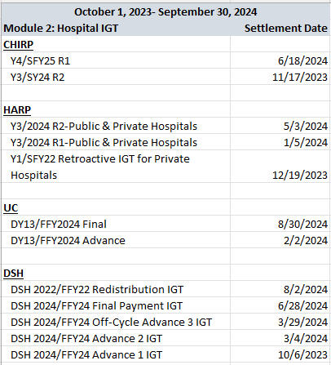
LoFTS FFY24 IGT Dates- Module 2

Slide 10
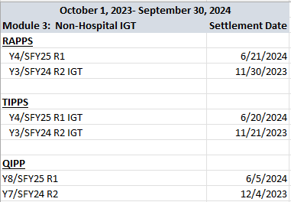
LoFTS FFY24 IGT Dates- Module 3

Slide 11
LoFTS Reporting Reviews
In-Depth Reviews
  Anything other than a taxing entity IGT for a governmental provider is subject to risk.
  QIPP issues are anticipated.
  Current in-depth reviews are over FFY23 Modules 2 and 3 (notices received August).
Identified Issues Sent to HHSC
  HHSC May Forward to CMS
    CMS Would Determine Approval or Denial for Continued Program Participation
  HHSC May Decide Not to Accept IGT From an Entity Moving Forward.
Notes:
Year 1, 114 out of 163 Module 2 Participants Were Selected

Slide 12
CHIRP- Program Structure Y4/SFY25
Payments on Medicaid Managed Care (STAR & STAR+PLUS) $6.1B
SFY25 Has 3 Components
  Component 1: UHRIP (Uniform Hospital Rate Increase Program) $3.05B
    Rate enhancement on Medicaid Managed Care claims (IP & OP)
    Based on Medicare rates
  Component 2: ACIA (Average Commercial Incentive Award) $2.01B
    Rate enhancement on Medicaid Managed Care claims (IP & OP)
    Based on ACR
    “Optional”
  Component 3: APHRIQA (Alternate Participating Hospital Reimbursement for Improving Quality Award) $1.05B
    ONLY for Urban and Children’s Hospitals SFY25
    APHRIQA funds transitioned from UHIRP and ACIA
    Pay-for-Performance
    “Optional”

Slide 13
CHIRP- Payment Structure Updates
Y4/SFY25 Components 1 & 2
  STAR and STAR+PLUS No Longer Have Identical Rates
  Payments will be delayed until after December 1, 2024
    MCO Contract Adjustments w/Adjusted Capitation Rates
Y5/SFY26 Proposed
  Comp 2 will use aggregated ACR gap withing a class & SDA
Y6/SFY27 Proposed
  Comp 2 max payment not to exceed 95% of total est ACR UPL
Y7/SFY28 Proposed
  Comp 3 max payment not to exceed 100% of total est ACR UPL

Slide 14
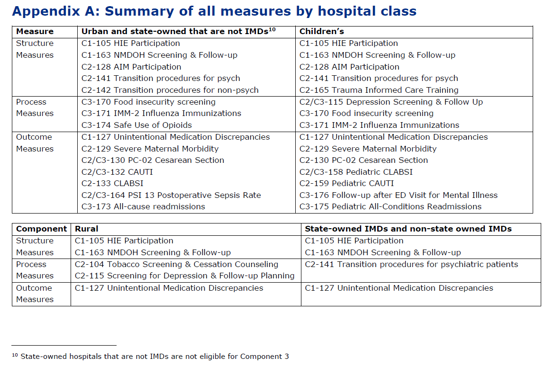

Slide 15
CHIRP- Reporting
Semi-Annual Reporting
  Round 1 in October
    Starting SFY25, October reporting will ONLY be over structure measures for rural hospitals.
    Required iamonline portal access.
  Round 2 in April
    April reporting will be for data measures; performance year data only reported once a year
April 2025- Data Measures (Process & Outcome Measures)
  Must be able to differentiate different types of Medicaid.
  Measures for Components 1 & 2 must report CY2024 data.
  Must CLOSELY adhere to measures specifications.
  Some changes to existing measures.

Slide 16
CHIRP- Reporting Measure Updates
Component 1- No major changes to process measure (Gold Standard Med Rec)
Component 2- Tobacco Use: Screening & Cessation Intervention (C2-104)
  New
    Age change from 18 years and older to 12 years and older as of 1/1/2024.
  Key Elements
    No exclusions for medical reason for not screening; only exclusion is Hospice.
    Use most recent screening of CY2024.
    Screen for any tobacco use; not just “smoking”. Include e-cigs, vape
    Counseling/pharmacotherapy can occur 7/1/2023- 12/31/2024.
    Numerator MET= Patients who were screened as non-tobacco users AND tobacco users who received counseling/pharmacotherapy during the needed timeframe.
      NOT MET= Patients who were not screened during CY2024 AND tobacco users who were not given counseling/pharmacotherapy during the needed timeframe.

Slide 17
CHIRP- Reporting Measure Updates (cont’d)
Component 2- Depression Screening & Follow-Up Plan (C2-115)
  New
    No exclusion for previous depression dx; keep exclusion for previous bipolar dx.
  Key Elements
    Patients 12 years and older as of 1/1/2024.
    Exclude patient refusals & patients w/ documented reason not to screen
    Screening tool must be age-appropriate, validated tool (w/ tool name documented).
    Numerator Met= Patients aged 12 years and older screened on date of encounter (or up to 14 days prior) using an age-appropriate standardized tool, AND who received a documented follow-up plan within 2 days after the encounter if positive for depression.
      Follow-up plan MUST be discussed w/ patient at time of encounter.
      Suicide risk assessment or repeated screenings do NOT count as follow-up plans.
      Follow-up plans may include referrals, behavioral health evaluations, pharmacotherapy, psychotherapy, etc.
      NOT MET= Patients who were not screened during CY2024 and patients who were + for depression but did not have a follow-up plan.

Slide 18
RAPPS- Program Structure Y4/SFY25
Payment on Medicaid Managed Care (STAR, STAR+PLUS, & STAR Kids)
SFY24 Had 2 Components
  Component 1- 75% of Program Funding
    Paid by increase in PMPM MCO payments
  Component 2- 25% of Program Funding
    Paid by rate enhancement on select CPT codes (preventive care and services to manage chronic conditions)
SFY25 Has 1 Component
    Paid by monthly lump sum based on monthly scorecard (no more rate enhancements)
    Same measures as SFY24, combined into 1 component

Slide 19
RAPPS- Reporting
Semi-Annual Reporting
  Round 1 in October
    Starting SFY25 October reporting will ONLY be over structure measures.
    Required iamonline portal access.
  Round 2 in April
    April reporting will be for data measures; data only reported once a year
April 2025- Data Measures (Process & Outcome Measures)
  Must be able to differentiate different types of Medicaid.
  Measures must report CY2024 data.
  Must CLOSELY adhere to measures specifications.
    Only 1 measure w/ major updates (flu measure)

Slide 20
RAPPS- Reporting Measure Updates
Influenza Immunization (R1-103)
  New
    No exclusion for anaphylaxis; only exclusion is Hospice.
  Possibly New, NOT Confirmed on HHSC Sites
    Denominator Inclusion has been patients aged 6 months and older as of 1/1/24 who were seen for a visit October 1, 2023- March 31, 2024.
      HHSC has indicated they intend to ALSO require the patient to have had a visit during CY2024 to first fit RAPPS Attributed Population. This has NOT been published.
  Key Elements
    Patient attestations to receiving the immunization count as MET.
    Numerator MET= Patients who received the influenza immunization OR who reported previous receipt of the immunization July 1, 2023- June 30, 2024.
      NOT MET= Patients who were not screened during CY2024 AND patients who did not receive a flu shot during the needed timeframe.

Slide 21
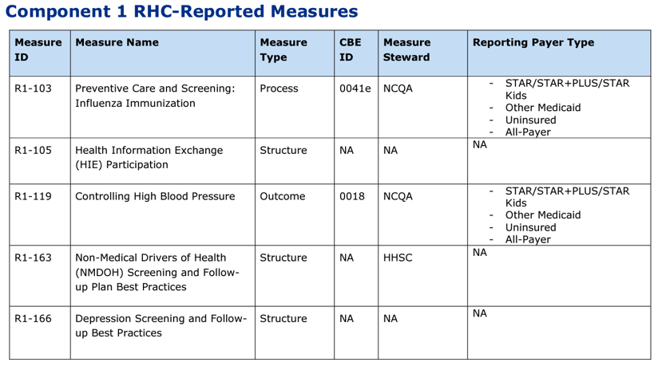

Slide 22
CHIRP & RAPPS Reporting- HHSC Reviews
SFY24 Round 1 October Reporting
  CHIRP out of 391 providers:
    221 Data Quality Concern flags
  RAPPS out of 181 providers:
    117 Data Quality Concern flags
  Data Quality Concern Flags
    Numerator and denominator descriptions; MUST be very specific in detailing data steps
    Payer issues; Medicaid Managed Care is not being properly identified
    Measure specifications are not being strictly followed
    Randomness of sample must be detailed
SFY24 Round 2 April Reporting
  CHIRP out of 391 providers:
    23 providers had 32 metrics NOT MET for Conditions of Participation; POTENTIAL RECOUPMENT
    105 providers had 132 Data Quality Concern flags
  RAPPS out of 181 providers:
    16 providers had 18 metrics NOT MET for Conditions of Participation; POTENTIAL RECOUPMENT
    91 providers had 103 Data Quality Concern flags

Slide 23
QIPP- Eligibility Rule Changes
NSGO nursing facilities must be in same county or county contiguous to NSGO owner, if no Active Partnership.
CHOW Rule Changes
  Active Partnerships must begin 9 months prior to enrollment Y9/SFY26.
    2 months prior to enrollment for Y8/SFY25
  If Active Partnership was NOT started by June 2024, NF would not be eligible to continue for QIPP Y8/SFY25 OR Y9/SFY26.
    Eligibility would resume in Y10/SFY27.
Must serve patients with STAR+PLUS Medicaid Managed Ca
Notes:
Previous distance rule was same RHP or within 150 miles.
Y9/SFY26 Enrollment March 2025

Slide 24
QIPP- Y8/SFY25 Funding Rule Changes
Funds for ALL components will be distributed quarterly based on performance.
  Quarter 1 metric achievement started with July 2024 MDS submissions,
    Except Component 2, which is based on actual staffing hours PPD.
Estimated Quarterly Payment Dates
  1st Quarter HHSC shows 2/24/2025, but may be delayed until March/April
    8-10 Months After R1 IGT Submission 6/5/2024, and 2-4 Months After R2 IGT Submission- Anticipated 12/4/24
    Next IGT Submission Due 4 Months Later (Y9/SFY26 R1)- Anticipated June 2025
  2nd Quarter 5/21/2025
  3rd Quarter 8/21/2025
  4th Quarter 11/24/2025
Y8/SFY25 Component 1 Achievement will not fully cover IGT.
  Will require additional component achievement to cover IGT shortfalls with STAR+PLUS Medicaid Managed Ca
Notes:
Minimum Data Set submissions to CMS, as required federally.
Per Patient Day
Component 1 now 44% of program funding

Slide 25
QIPP- Y8/SFY25 Funding Rule Changes (cont’d)
Undispersed Funds- Now contingent upon 16 hours of unduplicated RN coverage for 90% of the days of the month.
  If 1 month is missed, the Quarter is ineligible to receive Undispersed Funds (& potentially the full Year 8).
Management Agreement Amendments May Be Needed
  NF must meet at least 1 metric in Component 1 per Quarter
  If all Components are not sufficient to reimburse Operator’s IGT for PY
    Unreimbursed IGT may be deemed by Operator as a fee payable to Operator by Managers with STAR+PLUS Medicaid Managed Ca
Notes:
Funds that are non-distributed due to a failure of 1 or more NFs to meet performance requirements (“non-disbursed funds”) will be distributed across NFs who have demonstrated achievement of an HHSC-chosen quality metric. For Y8/SFY25: The NF maintains 8 additional hours of RN staffing coverage per day, for 90% of the days in each month of the program period, beyond the CMS mandate of onsite RN coverage 8 hours a day, 7 days a week.
Meeting 1 Comp 1 metric= 90% of Comp 1 funds. (90% of 44% of program funding= 39.6%, close to the state share of IGT except that IGT is calculated at 8% additional)

Slide 26
QIPP- Y8/SFY25 Program Structure
4 Components (All Pay for Performance):
  Component 1- 44% of program funds- Hospital Partner Minimum Data Set (MDS) Quality Measures
    Must meet targets in at least 2 of 5 metrics to earn 100% of eligible component funds.
    Achievement in only 1 target will earn 90%.
  Component 2- 20% of program funds- Workforce Development
    Must meet targets in at least 2 of 3 metrics to earn 100% of eligible component funds.
    Achievement in only 1 target will earn 70%.
  Component 3- 20% of program funds- TX Priority MDS Quality Measures
    3 equally weighted metrics.
    Must meet targets in all 3 metrics to earn 100% of eligible component funds.
  Component 4- 16% of program funds- Resident Focus MDS Quality Measures
    2 equally weighted metrics.
    Must meet targets in both metrics to earn 100% of eligible component funds.

Slide 27
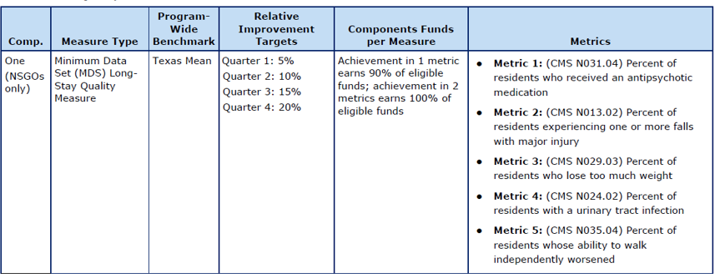
QIPP- Reporting
Currently a QIPP Reporting Portal
SFY25 Will NOT Require NFs to Report Data or Documentation to HHSC
  Previously monthly reporting & PIP updates.
  NFs report MDS assessment data to CMS.
  Quarterly performance will be based on Public Use Files published by CMS.
Metrics
Notes:
Reverse directionality

Slide 28
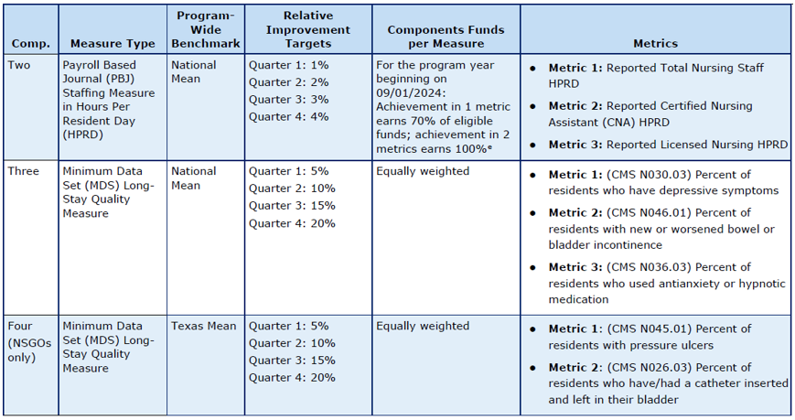
QIPP- Reporting (cont’d)
Notes:
HPRD- Hours Per Resident Day

Slide 29
ATLIS- Program Overview
Not Yet Fully Approved
  PY1 Scheduled to begin September 1, 2024
  To be released in a limited scale for SFY2025
    Limited Managed Care Service Areas and Products
      Children’s hospitals earn payments in STAR Kids.
      Rural and urban hospitals earn payments in STAR+PLUS.
      5 SDAs receive payments in STAR (Bexar, Dallas, Jefferson, Nueces, & Tarrant).
    SFY25 Total Value $690M
      Suggested minimum payment= LARGER of $275,000 or value of hospital’s projected CHIRP reduction from SFY24 plus 10%.
  Intended to be a 5-year program, SFY2025- SFY2029

Slide 30
ATLIS- Funding
Funding
  CHIRP will still exist.
    Rural hospitals anticipated to lose $84M in CHIRP SFY25 BUT gain $200M in ATLIS
      Many rural hospitals ended up seeing an increase in CHIRP funding IN ADDITION to ATLIS funding.
    Payments/IGT- 2 ATLIS payments, six months apart
    First IGT anticipated January 2025
  Transition During the 5 Year Period
    CHIRP back to 2 components; UHRIP based on Medicare rates, ACIA based on ACR
      No Pay-for-Performance
    ATLIS will initially pay out more and then transition to CHIRP

Slide 31
ATLIS- Reporting
Reporting/Metrics
  Based on HIE connectivity; details not fully released
  Proposed to be submitted by MCOs; certifications from each provider
    Round 1 due November 1, 2024
    Round 2 due May 1, 2025

Slide 32
Key Dates-
Enrollment, IGT, Reporting
  DSH FFY25/UC DY14 Application Request Due September 27, 2024
  UC DY13/FFY24 Final Payment Expected September 30, 2024
  DSH FFY25 Advance 1 of 2 IGT Due October 9, 2024
  LoFTS FFY24 Reporting Anticipated Due October 31, 2024
  CHIRP SFY24 Round 1 Reporting Due October 31, 2024
  RAPPS SFY24 Round 1 Reporting Due October 31, 2024
  HARP Y4/FFY25 Enrollment November 2024
  CHIRP Y4/SFY25 Round 2 IGT Due November 15, 2024
  DSH FFY25/UC DY14 Apps Due (If No Extension) November 25, 2024
  RAPPS Y4/SFY25 Round 2 IGT Due November 22, 2024

Slide 33
Key Dates(cont’d)
Enrollment, IGT, Reporting
  QIPP Y8/SFY25 R2 IGT Due December 2, 2024
  DSH FFY25/UC DY14 Apps Due (If Had Extension) December 10, 2024
  HARP Y2/FFY23 Retroactive IGT (Private Hospitals Only) December 16, 2024
  HARP Y4/FFY25 Round 1 IGT Due January 6, 2025
  ATLIS Y1/FFY25 R1 IGT Due January 7, 2025
  UC DY14/FFY25 Advance IGT Due February 3, 2025
  CHIRP Y5/SFY26 Enrollment February 2025
  RAPPS Y5/SFY26 Enrollment February 2025
  QIPP Y9/SFY26 Enrollment March 2025
  DSH FFY25 Advance 2 of 2 IGT Due April 1, 2025
  DPP Y4/SFY25 Round 2 Reporting Due April 30, 2025

Slide 34
How Do We Assist with DPPs?
Program Education
  Metric and Reporting Changes
  DPP 101 Sessions
Deadline Reminders
Reporting
  Complete Service (Data, Disaggregation, Template Completions, Submissions)
  Guidance for How to Pull Data
  Clarification on Measure Specifications
  Qualitative Responses
    HHSC is VERY Picky About Wording!
  Reporting Workshops Starting w/April 2025 Reporting
  Template Review Prior to Submission

Slide 35
How Do We Assist with DPPs? (cont’d)
Guide Hospital/Clinic Internal Processes
  IT Team, Quality Team, Board for Changes
    Data Capture
    Processes/Procedures
Payment Questions
  Estimated Payments
  IGT
  Payment Tracking (MCOs)
IGT
  Pooled IGT Tracking

Slide 36
State DSH/UC (DY 14- SFY 2025) Developments
Request application on-line by September 27, 2024.
Data Year is 9/30/2023 with cost report year ending in 2023.
  Don’t just take 2023 for what it is….think about what your FY 2025 will look like
    Ie. Did you make a change in policy or processes? Add a service? Increase costs?
Application submission will be due 30 days from release date
  We anticipate app to be released on October 25th
  Two-week extension will likely be granted – Due date tentatively December 6th
New – Section 203 Exception to CAA 2021
  Qualifying hospitals have option to use the higher of two DSH HSL’s - With or without Medicare cost and payments.
  First affected year was 2024 (DY 13) DSH application filing
  Appeals were made to HHSC
  Hospitals must file exception request with filing of the 2025 DSH/UC application.

Slide 37
State DSH Proposed Rule Amendment
Will Deem ALL Rural Hospitals eligible for DSH
Will Exempt ALL Rural Hospitals from the trauma system COP
What Does This Mean?
  Must meet all other federal conditions of participation (COP) and eligibility requirements (ie. 1% MIUR (Medicaid Inpatient Utilization Rate – includes traditional Medicaid and Medicaid MCO) and 2-physician requirement)
  Exempt from 2-physician requirement if your hospital was open as of 12/22/1987 and not offering non-emergent OB services
  Trauma Designation not an issue any longer
  HHSC will have the flexibility to issue advance FFY 2025 DSH payments to rural hospitals that would have qualified in FFY 2024 under the new deeming criteria. <-this should improve cash flow for 24 rural hospitals.

Slide 38
State DSH Proposed Rule Amendment (cont’d)
We don’t do deliveries…..do we qualify??
MUST consult with legal counsel
  Agreement Considerations (and must be in place before application is submitted)
  Insurance Coverage Considerations
  Bylaw Changes/Considerations
  Medical Staff Privileges Changes/Considerations
  Equipment may be needed
  What’s your process now? The provider(s) will HAVE TO respond
What This Means: If your facility meets all other federal conditions of participation and eligibility requirements (ex: 1% MIUR and 2-physician requirement), you may now qualify for DSH participation even without a trauma designation.

Slide 39
UC Considerations
UC pool is REQUIRED to be resized for DY 17-19 (SFY 2028-2030)
  $1 Billion to be reallocated to High Impecunious Charge Hospitals (HICH)
Write Off’s during Fiscal Year must continue and be consistent!
  Remember the UC App is based on YOUR FY whereas UC Audit is on STATE FY
Federal Poverty Level (FPL) Increases/Decreases
Catastrophic Language
Prompt Pay Discount or Self Pay Discount
  S-10 Audit pushback on prompt pay discount wording, but not self pay
What This Means: If your facility meets all other federal conditions of participation and eligibility requirements (ex: 1% MIUR and 2-physician requirement), you may now qualify for DSH participation even without a trauma designation.

Slide 40
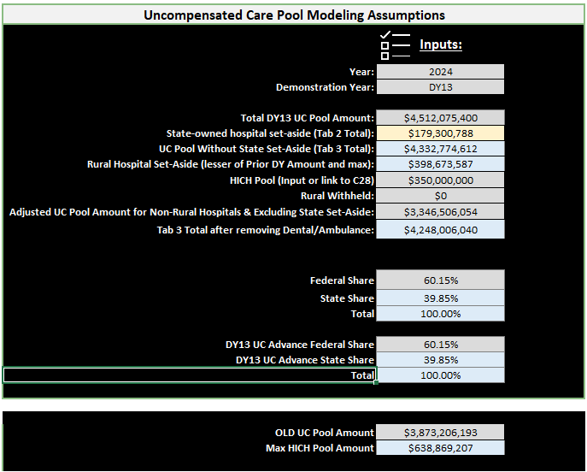
UC Modeling Assumptions
What This Means: If your facility meets all other federal conditions of participation and eligibility requirements (ex: 1% MIUR and 2-physician requirement), you may now qualify for DSH participation even without a trauma designation.

Slide 41
WHAT IS HICH?
HICH = High Impecunious Charge Hospital
  A Hospital that has high charges and serves a population that is financially constrained
    Equal to or greater than 27.5% using DSH uninsured charges and uninsured charity charges (minus any duplication) when compared to total allowable hospital revenue
  All Rural Hospitals
  All State-Owned Hospitals
HICH Pool determined at an amount less than the difference in the total UC Pool in DY 12 and the total UC pool in DY 11 – but ultimately determined by HHSC annually
Starting in DY 17, HICH will become the 1st payment made in UC, before any non-HICH hospitals receive payments
What This Means: If your facility meets all other federal conditions of participation and eligibility requirements (ex: 1% MIUR and 2-physician requirement), you may now qualify for DSH participation even without a trauma designation.

Slide 42
WHAT IS HICH? (cont’d)
177 of 371 hospitals qualified for HICH in DY 13
  12 IMD facilities ($677,803)
  153 Rural facilities ($12,041,164)
  12 Non-Rural facilities (qualified based on 27.5% rule- $331,287,033)
    $164 million went to one facility
  194 facilities NOT qualified
Calculation
  Rural Hospitals/IMD’s get their UC Cost
  Other Hospitals get their (UC Cost/Total UC Costs) * Designated HICH Pool
    HICH Pool was $350,000,000 in DY 13
What This Means: If your facility meets all other federal conditions of participation and eligibility requirements (ex: 1% MIUR and 2-physician requirement), you may now qualify for DSH participation even without a trauma designation.
Notes:
Still discussing with HHSC how the calculation is going to work and where the UC Cost * 27.65%

Slide 43
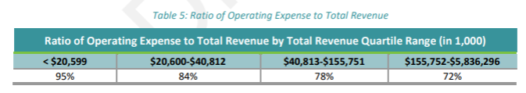
Article IX Sec. 17.34: Charity Care and Hospital Transparency—Draft Report Available
CHARITY CARE & HOSPITAL TRANSPARENCY - Draft Report
What did the 599 page draft say?
  Duplicated reports: AHA Survey, Cost Reports, Supplemental Payment Program Applications (DSH/UC, CHIRP, RAPPS, HARP, etc), IRS 990, CHNA, LoFTS
  Timelines and Deadlines are overly compressed
  37 Governmental entities & hospital districts with $3.8 Billion of outstanding bond debt
  Each individual hospital revenue sources, charity/bad debt/unreimbursed cost, operating cost, charity care criteria (pages 38-599)
What This Means: If your facility meets all other federal conditions of participation and eligibility requirements (ex: 1% MIUR and 2-physician requirement), you may now qualify for DSH participation even without a trauma designation.
Notes:
Report is due to legislature on 12/1/2024
HHSC allowing 30 days for comments on the draft – October 11, 2024
pfd_hospitals@hhsc.state.tx.us

Slide 44
Reimbursement Reporting
Updates

Slide 45
Some things to Know
Current Legislation
  Rural Emergency Hospital Adjustment Act – S. 3394 - H.R. 8246
    Revision of eligibility on REH certification for closed or discontinued operations.
  Medicare Advantage Consumer protection Act – H.R. 5854
    Requires MA plans to report additional information to CMS, incl encounter data, additional claims data, number of coverage denials.
  Rural Health Care Access Act – H.R. 1128
    Permits states to designate CAH, without any mileage criteria for hospital located in rural areas.
  Save America’s Rural Hospitals Act - H.R. 833
    Proposes CAH qualification for hospitals serving in a HPSA, high number of low-income patients, experienced losses for two consecutive years, and has a plan for hospital’s sustainability.
  Rural Hospitals Support Act – S. 1110
    Adjust SCH and MDH payment rates to 2016 (if higher) and makes MDH and LVP permanent
Notes:
None of these will likely have any passing or movement in Congress this year – hopefully will be reinitiated next year.
REH adjustment Act – a hospital can receive REH certification if closed after January 1, 2014 (HR) and January 1, 2015 (S)
MA plan protection Act – requires the reporting of transparency data to CMS including claims data, denied claims data, denials as a percentage of total claims, authorizations preceding denials, etc.
H.R. 1128 and H.R 833– likely will not pass, very costly, but worth mentioning that it’s there.

Slide 46
Update on Price Transparency
Additional Machine-Readable File (MRF) Fields + Information
  Include drug units and type of measurement.
  Specify the code type for each code with applicable modifiers.
  For payer-specific negotiated charges, include three fields: dollar amount, percentage, and algorithm.
  Add a field showing the average dollar amount estimated to be paid by a third-party payer.
  Define the methodology for each standard charge from the CMS-prescribed list.
January 2025

Slide 47
Federal DSH Developments
Supplemental Security Income (SSI)
  SSI percentage is one of the factors in calculating Federal DSH reimbursement.
  SSI is the percentage of patient days which are eligible for both Medicare Part A and SSI.
  The numerator of the SSI fraction represents SSI days
  The larger the numerator the larger the SSI fraction becomes.
  This fraction is added to the Medicaid Fraction which makes up the total Federal DSH percentage.
  SSI’s are calculated based on the federal fiscal year end, 9/30.
  Hospital year ends that are not 9/30’s have an opportunity to change the SSI fraction to the hospital year end.

Slide 48
Federal DSH Developments (cont’d)
Recent Activity
  CMS Transmittal 13413, effective July 31, 2024.
  Allows for SSI realignment requests for periods beginning prior to 10/1/2013.
  Once requested, the request may not be rescinded for at least one complete cost reporting period. <- we are recommending this be delayed for potential changes
Action Steps
  Perform high level opportunity analysis.
    Evaluate SSI trending
  Hold off for now on requesting SSI realignment, even if beneficial, in light of a pending Supreme Court Case (Advocate Christ) which may impact the SSI fraction.
  Other cases and factors may impact the SSI ultimate results.

Slide 49
Rural Hospitals & Graduate Medical Education (GME) Programs
Potential Help for Physician Shortage
  Recruiting –program may attract physicians interested in teaching
  Residents more likely to practice where they trained
Medicare reimburses when it’s an approved GME program
  Medicine
  Osteopathy
  Dentistry
  Podiatry

Slide 50
Rural Hospitals & Graduate Medical Education (GME) Programs (cont’d)
Start New Training Program
Participate in Rural Training Program (RTP)
  Can be any specialty, not just Family Medicine
  ACGME accredited and where residents (either all or a subset) spend greater than 50% of their training in the program in a rural area
  Urban hospital is a sponsor
  Provides a training rotation site for an existing program

Slide 51
How does the GME Payment Work?
Direct GME
  Costs directly related to the training of residents
    Salaries/Stipends
    Fringe Benefits
    Other direct expenses
  Payment formula based on a per-resident amount and subject to FTE caps
  Separate pass-thru payment

Slide 52
How does the GME Payment Work?
Indirect GME
  Reimburses teaching hospitals to account for higher indirect patient care
  Added to DRG payments paid under Medicare IPPS
  Payment formula looks at:
    PPS Bed Count
    Resident FTE’s
    Average Daily Census
    Annual FTEs of residents/FTE Cap
    Statutory payment formula

Slide 53
GME – HRSA Funding Opportunities
HRSA Rural Residency Planning and Development Program (RRPDP) – Opportunity Number: HRSA 25-007
Criteria:
  Expand access to health care in rural areas
  Develop new and sustainable rural residency program
  Includes Rural Track Programs (RTP)

Slide 54
More Changes?

Slide 55
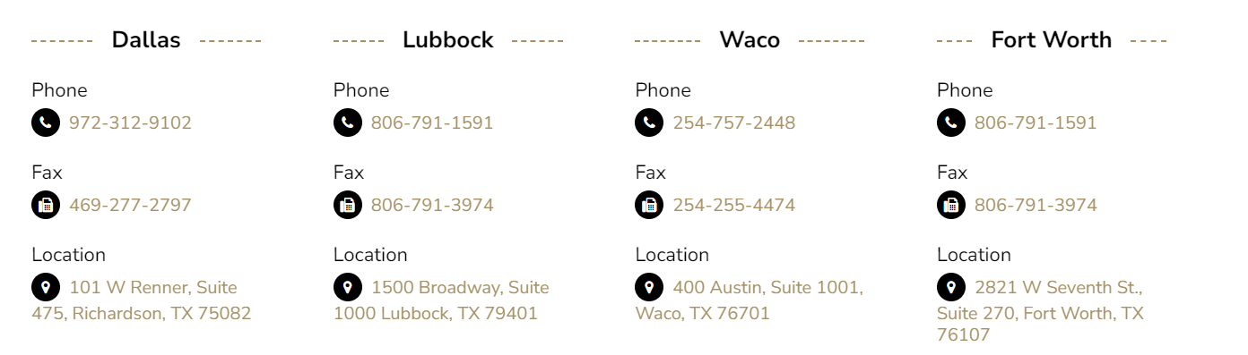
Questions?

