Slide 1
TORCH Conference
Spring 2025

Slide 2

AGENDA
Medicare Advantage
Supplemental Funding (DSH/UC)
Physician Engagement/ ER

Slide 3
What is the state rural hospital financial condition?

Slide 4


Slide 5
TOP THREATS
We need to address the payment models between Advantage and Traditional Medicare.
  CAH program
  Low Volume
  Volume Decrease Adjustments
  Sole Community / Medicare Dependent enhanced payments
Growth in Medicare Advantage and Medicaid MCO Payment Models

Slide 6
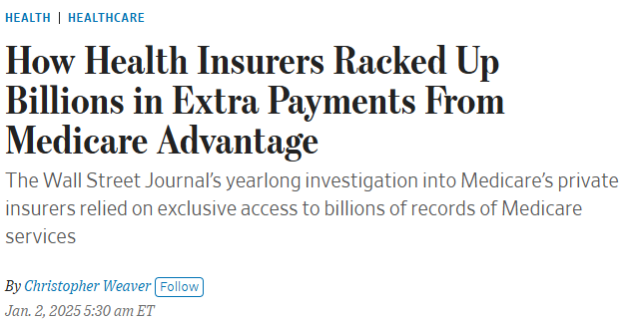
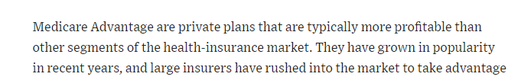
RECENT WSJ NEWS
Notes:
Paragon Health Institute Report

Slide 7
Medicare (Dis)-Advantage
Impact on Rural Healthcares
What’s the Problem w Advantage Plans?
  Simply said – many of these MA plans do not pay what Traditional Medicare pays,.
    This includes CAH, FFS & PPS based payment.
    No bad debt payment
    No Low Volume payment
    No SCH or MDH
    Some pay Swing Bed at RUGS rate and not CAH rate, and those that pay CAH rate, the contract is difficult.
      If it is quoted as nursing home rate, that means RUG rate
Notes:
Watch Contract language

Slide 8
Medicare (Dis)-Advantage
Impact on Rural Healthcares
What’s the Problem w Advantage Plans?
  Traditional Medicare (TM) Pays an average of 82% of Hospital cost on Medicare patients (AHA, 2022 study).
  Medicare Advantage pays an average of 88% of the Amount TM pays, or 72% of Cost, yet receives approx. 104% of the funding that traditional Medicare would have spent on these beneficiaries. (AHA, 2022 study)
  Hospitals in highest MA transition states are the most impacted.
      Utah still has the lowest transition rate to MA and also has least number of hospitals operating in negative margins, per capita.
Notes:
Pre-auth language

Slide 9
Medicare (Dis)-Advantage
Impact on Rural Healthcares
Confusing Contract terminology and Terms of Payment
Enhanced Medical Claims Review and Claim Rejection / Denials
Delay in Rate Adjustment (especially with Rate Increases) and no settlement process.

Slide 10
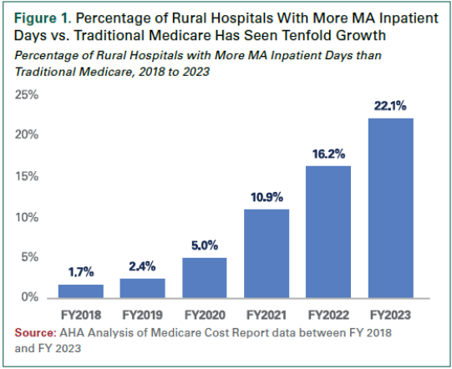
Medicare Advantage
Growth of Medicare MA Market in Rural Hospitals
Notes:
Many MA plans have reconsidered the prior auth process – good news.

Slide 11
Medicare Advantage
Growth of Medicare MA Market in Rural Hospitals
Medicare Advantage in Rural Areas
Medicare Advantage enrollment has quadrupled in rural areas since 2010 and reached 40% in 2023.
In 2023, a smaller share (40%) of Medicare beneficiaries in rural areas – counties with less than 10,000 people – are enrolled in a Medicare Advantage plan than Medicare beneficiaries in micropolitan (10,000 to 50,000 people) or metropolitan (at least 50,000 people) areas (44% and 53%, respectively). Though Medicare Advantage enrollment is lowest in rural areas, it has grown more rapidly in these counties, nearly quadrupling from 11% of eligible Medicare beneficiaries in 2010 to 40% in 2023. Over the same period, the share of Medicare beneficiaries enrolled in a Medicare Advantage plan in micropolitan areas nearly tripled (from 15% to 44%), and nearly doubled in metropolitan areas (from 27% to 53%).
Source: KFF (Kaiser Family Foundation) Healthcare Policy Research –https://www.kff.org/medicare/issue-brief/medicare-advantage-enrollment-plan-availability-and-premiums-in-rural-areas/
Notes:
Percentages
58.6M Americans on Medicare in 2020 – Rural has 20% of those (11.7M) - Percentage of MA in 2020 = 10.38% of MC
67M in 2025 – Rural has 20% of those (13.4M) – Percentage of MA in 2025 -

Slide 12
Medicare Advantage
Growth of Medicare MA Market in Rural Hospitals
Population Statistics
In 2018 - 2020 – approx. 63M Americans were enrolled in Medicare
  Approx 15-20% of those are in Rural US areas – 9.5M rural MC benefic.
    Approx. 1,214,222 or about 12.75% of Medicare was enrolled in MA
  In 2024 – approx. 67M Americans were enrolled in Medicare
    Approx 10% of those are in Rural areas – 6.5M rural MC Benefic.
      Approx. 3.4M or about 51% of Medicare is enrolled in MA
  In 2025 - Texas has 4.9M Medicare benefic. and 15% in rural areas – 735,000 rural
      Approx. 408,000 Texans enrolled in MA plan – 55.5% MA enrollees as of April 2025.
Notes:
Percentages
58.6M Americans on Medicare in 2020 – Rural has 20% of those (11.7M) - Percentage of MA in 2020 = 10.38% of MC
67M in 2025 – Rural has 20% of those (13.4M) – Percentage of MA in 2025 -

Slide 13
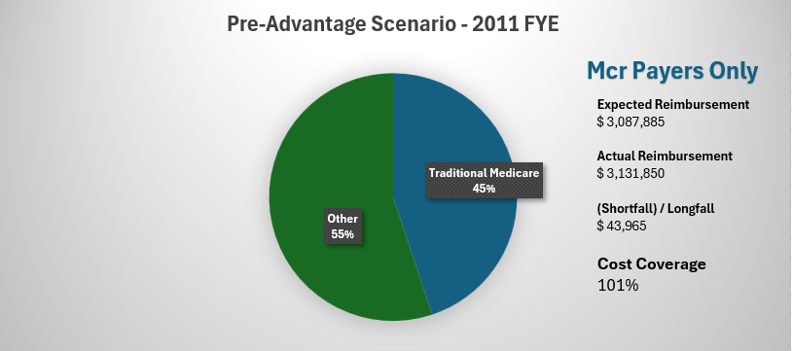
Medicare Advantage Comparative
Impact on Rural Healthcare – CAHs

Slide 14
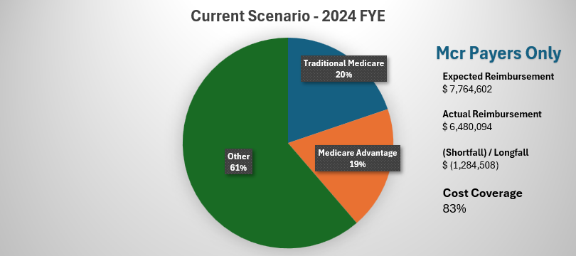
Medicare (Dis)-Advantage Comparative
Impact on Rural Healthcare – CAH s
  Overall, CAH hospitals reviewed to this point, we know that a large amount of short-fall is denied claims.
Notes:
Average over all hospitals is that about $306,000 appears to likely be related to claims denials. This is across IP, OP, and Sw Bed and some hospitals had much more, some much less.

Slide 15
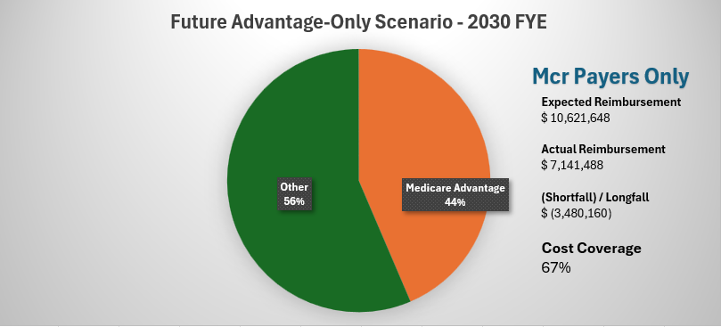
Medicare (Dis)-Advantage Comparative
Impact on Rural Healthcare – CAH

Slide 16
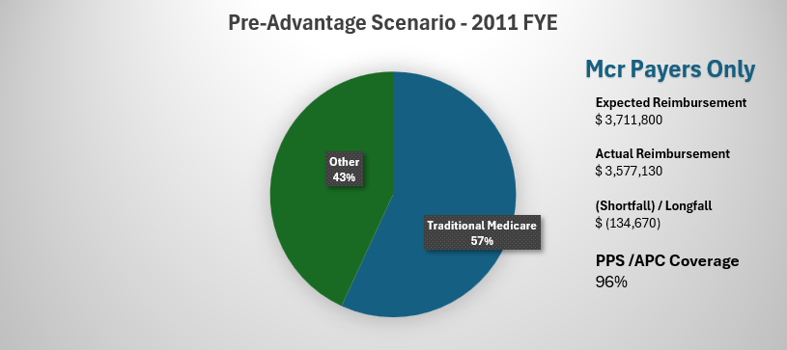
Medicare Advantage
Impact on Rural Healthcare – PPS s

Slide 17
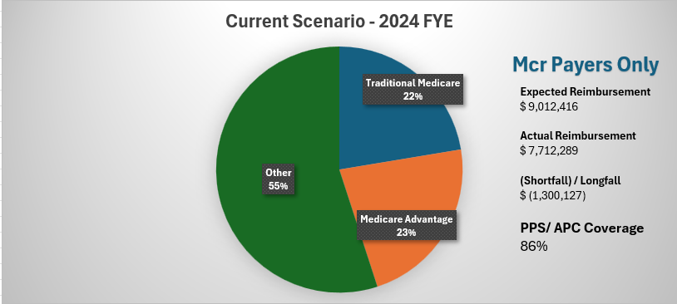
Medicare (Dis)-Advantage
Impact on Rural Healthcare – PPSs
  Overall, a common stat we see between all hospitals, a large amount of short-fall is denied claims.

Slide 18
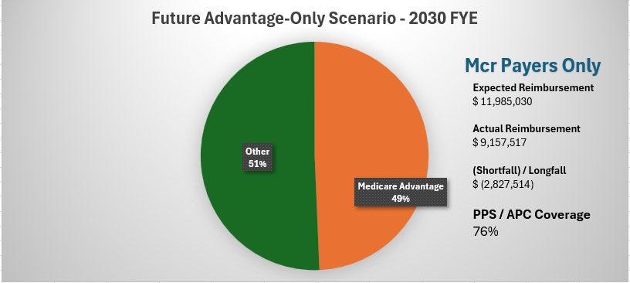
Medicare (Dis)-Advantage
Impact on Rural Healthcare – PPSs

Slide 19
CONTRACT SOLUTIONS
Steps toward a better payment structure:
  Inpatient and swing-bed admissions –
  Renegotiate contracts:
    Watch for lower of Cost or Charge clauses in contract, which contradicts the cost
    Eliminate or reduce Medicare RUG rate or NF rate schedules – esp CAHs
    Target rates should be same as Traditional Medicare
    Include Bad Debt Reimb Estimate
  Continue to Appeal or contest denied claims volume
    Track and record claims denials and perform analysis on volume of payment reductions
  CAHs need to update rates timely, as there is no settlement
  PPS hospitals should include Bad Debt estimate as well
    Also, Federal DSH, Low Volume, SCH and others, if applicable and qualifying
Notes:
No mandate or law supporting that rates must be same as traditional Medicare, but that should be target payment rates.
If PPS, for Swing-bed this should be full RUG rates
For CAH, this should be full swing-bed cost per diem.

Slide 20
LEGISLATIVE SOLUTIONS
Current Legislation -
  Two Bills in Congress to address / assist with Medicare Advantage payment models
    One dealing with Payment level review – Pre-authorization.
      Texas Gold Card
    One dealing with increased level of price transparency in data for MA plans.
    None addressing improvement of payment criteria or accountability.
  MEDPAC did just issue a report to Congress in March
Notes:
Claims Denials and Peer Review is probably the largest vulnerability among small hospitals, bc of the time spent away from healthcare.
By Updated payment schedule from the MA, reference is the payment pricing schedules – what we used to call ‘pricers’. Alternatively, the timeliness reference for CAH is quickly turning around most recent CR rates and Interim rates.

Slide 21
COMBATING ADVANTAGE
How do we change the tide back to traditional Medicare
Beckers cites that 15% of health systems have terminated Advantage, and that over 60% are looking at termination or limitation of plans.
Join TORCH in initiative to vocalize short-fall

Slide 22
What can you do?
How can you get your population to switch back to traditional Medicare?
Educate
  As simple as brochures in the hospital, to
  A coordinated community education program.
Political issues with refusing advantage
  – Yes, you will have some, but would they rather have a tax increase?
Working on ideas with TORCH.

Slide 23
Supplemental Funding:
DSH/UC

Slide 24
How Do We Assist with DPPs?
Program Education
  Metric and Reporting Changes
  DPP 101 Sessions
Deadline Reminders
Reporting
  Complete Service (Data, Disaggregation, Template Completions, Submissions)
  Guidance for How to Pull Data
  Clarification on Measure Specifications
  Qualitative Responses
    HHSC is VERY Picky About Wording!
  Reporting Workshop just took place on Monday & this past week- did we like it?
  Template Review Prior to Submission

Slide 25
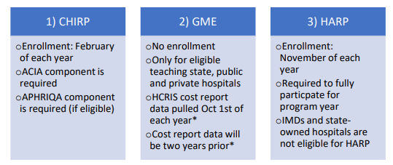
Common Misconception: To participate in DSH and/or UC, you must also apply for:
State-Owned and Rural Hospitals are Exempt!
Notes:
What do we recommend? That’s up to you! RAPPS for those with rural health clinics, HARP has no reporting or data…..

Slide 26
State DSH Proposed Rule Amendment – NOW FINAL
Will Deem ALL Rural Hospitals eligible for DSH
Will Exempt ALL Rural Hospitals from the trauma system COP
What Does This Mean?
  Must meet all other federal conditions of participation (COP) and eligibility requirements (ie. 1% MIUR (Medicaid Inpatient Utilization Rate – includes traditional Medicaid and Medicaid MCO) and 2-physician requirement)
  Exempt from 2-physician requirement if your hospital was open as of 12/22/1987 and not offering non-emergent OB services
  Trauma Designation not an issue any longer
Able to apply for DSH starting with DY 14 (2025) application
  Currently under review by HHSC – DSH inflator being applied to CHIRP payments and HARP/APHRIQA payments being included as offset

Slide 27
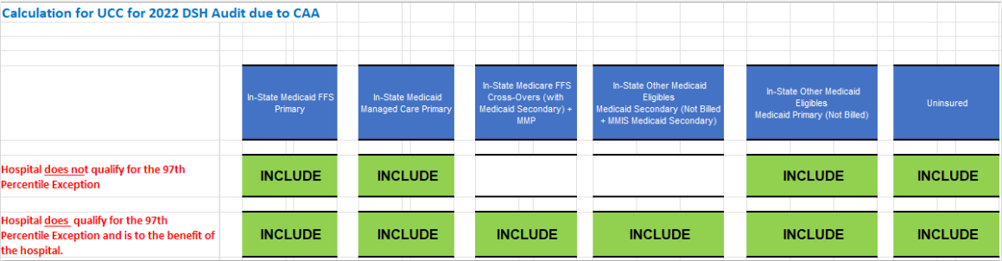
97th Percentile – Audit Impact
Federal FY 2022 (DY 11) is first year of impact
Previously a hospital’s DSH hospital specific limit (HSL) included costs and payments for all Medicaid and uninsured
Under this rule, Medicaid dual-eligible and unbilled Other Medicaid Secondary (OME) will NO LONGER be included relative to costs and payments unless the 97th percentile exception is met (we only have 2 hospitals we work with that meet this exception)

Slide 28
ENHANCED REVIEWS
Significant changes in requests and heightened review in the reporting requirements for almost every application and audit we assist with
  More data being requested at the claims level relative to transactions
    History being maintained is IMPORTANT
      If going through a conversion, preserve your rights to the data and don’t let charges fall off through archives, etc
  Business Office Education is IMPORTANT
  Operational Changes in Processes and Procedures need to be documented ← attestations allowed for DY 14, but will not be allowed going forward
Notes:
Internal Policy’s documented, training materials provided ← proof of operational procedure change

Slide 29
APPLICATION VS AUDIT
DSH/UC Application | DSH/UC Audit
• Submitted by hospitals to report Disproportionate Share/Uncompensated Care costs. | • Ensures compliance with DSH/UC program rules and documentation standards.
• Reviewed by HHSC after submission. | •Conducted by third-party auditors to verify DSH/UC costs. May lead to adjustments which might result in recoupment
• Occurs annually – every November. | • Occurs annually – every March for DSH and every May for UC.
• Based on Hospital Fiscal Year 2 Years Prior | • Based on Federal Fiscal Year pertaining to payment year (if not a 9/30, two years of cost data will be utilized and prorated)

Slide 30
IT’S ALL IN THE DETAILS
-how recoupments occur-
Swings in Medicaid Volume
COVID-19 Impact
  Payments for IP and OP offset costs
    We saw a lot of this relative to 2020 – 2022 audits
DSH and UC Overlap/”Duplication”
  CHIRP, APHRIQA, GME all are offsets now as well….ATLIS?
Overestimated Costs ← let’s discuss this further
Keep in mind, underestimated costs are just as costly – even though you don’t end in a recoupment
Notes:
2022 DSH Audit….3 with recoupments out of 40 total that we assist with

Slide 31
IT’S ALL IN THE DETAILS
-how recoupments occur-
“Overestimated” Costs
  For UC, charity being written off consistently and correctly matters
  For both DSH and UC Projections vs Actual matters
    Application for DY 14 (2025) utilized 2023 data….did you adjust for what would take place in 2025?
      Audit will true up numbers to 2025 so you should have

Slide 32
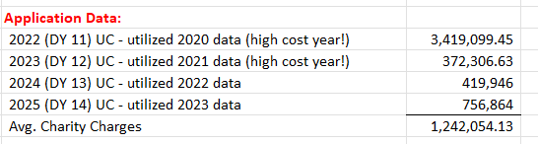
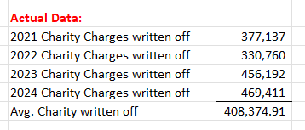
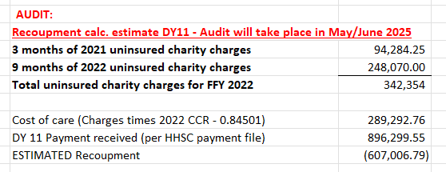
IT’S ALL IN THE DETAILS
-how recoupments occur-

Slide 33
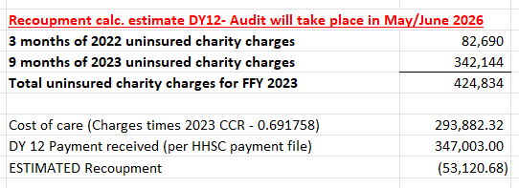
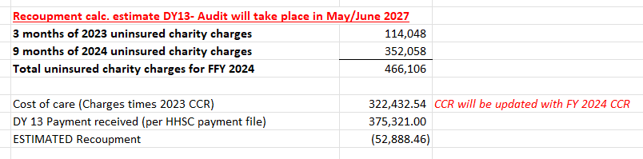
IT’S ALL IN THE DETAILS
-how recoupments occur-

Slide 34

What is the current state of physician engagement and any new strategic opportunities?

Slide 35
TRENDS IN 2025
A recent study revealed major trends impacting health systems in 2025, rural hospitals and their physicians share a similar path…
  Patients have returned, but volume growth is not translating to sustainable margins
    Expense reduction is the new normal in both hospitals and clinics
    Conduct a revenue cycle review of your clinics / revenue enhancement
  Physician employment does not ensure referral integrity
    Only 55% of employed PCP referral revenues remain with their employer
    58% of physicians are now employed by hospitals and corporate owners
    Healthy Physician/NP relationships begin during recruitment and continues through screening, onboarding, and continued rounding on new providers. Align expectations with culture.
    Discovery Medical Network – Since 2009, we’ve grown from 6 physicians to over 190 physicians and mid-level providers statewide.
Notes:
Recent Advisory Board study revealed 10 major trends impacting health systems, a few to highlight for rural hospitals:
Both hospitals and clinics must be vigilant at reducing expenses, focusing on smart growth is also imperative…
Are you maximizing your service lines/revenue?
Do you have work incentives in your physician Agreements?
85% of newly recruited physicans seek employment agreements
Corporate ownership now exceeds hospital owned practices
Almost 60% of all physicians are employed
Proper physician onboarding is imperative, and you must be transparent with your PCP’s about $$$
Only 55% of PCP referral revenues remain in their employer hospital (rural even less)
how their referral decisions impact your hospital
We have supported rural hospitals, employing 6 physicians in 2009 and today more than 190 physicians and midlevel providers statewide

Slide 36
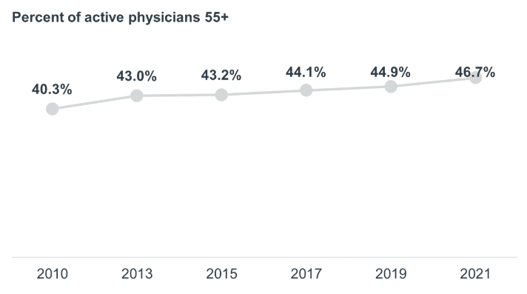
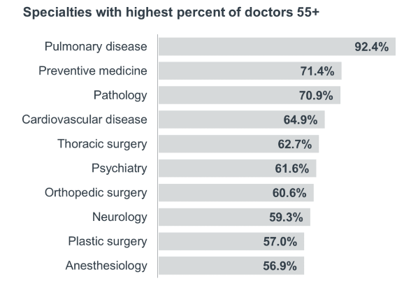
TRENDS IN 2025
We are on the brink of massive physician retirement…
Notes:
Atop all the other challenges in recruiting in rural Texas,
We are on the brink of massive physician retirement, with almost HALF of practicing physicians 55 or older
And ive highlighted the specialties your PCP’s most often refer to, and the average ages SOAR even higher.

Slide 37
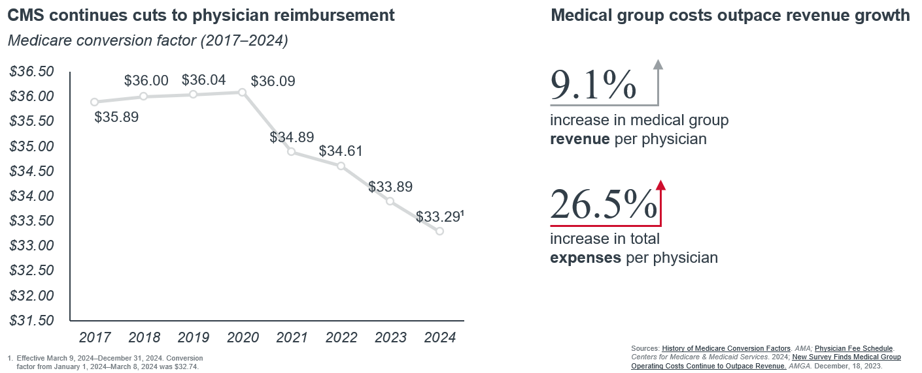
TRENDS IN 2025
It is always about the money…
Notes:
Overall, CMS continues to lower reimbursements, a contributing factor explaining why more physicians are migrating towards corporate ownership, seeking cost reductions, and lift in managed care contract reimbursements.
Increases in practice expenses have outpaced revenues for many Medical Groups.
{For primary care the reimbursements have actually adjusted upwards slightly in the last few years... As CMS places more emphasis on quality measures and VBC.)

Slide 38
TRENDS IN 2025
  Generational shifts in consumer/patient preferences… extended hours and urgent care
  Value based care and quality measures are here to stay... build incentives into your provider agreements and compensation
    MA plans faced significant headwinds in 2024
    Employers are still evaluating options to control cost growth
    VBC is coming for Specialists – TEAM launches 2026 payment bundling project
  Medicare Advantage Plan burdens… not just a hospital problem, a physician practice disrupter
    19% of hospitals stopped accepting one or more plans
    61% are considering dropping one or more plans
    Clinics are overwhelmed with differing measures between CMS programs
Notes:
- Generational shifts have changed patient preferences… ex. Urgent Care / extended hours is a key entry point for Gen Z
- VBC is here to stay for hospitals and physicians… CMS Quality initiatives exist regardless of MA or Traditional Medicare… engage clinics and incentivize providers to meet quality measures
MA plans faced significant headwinds in 2024 -
Employers are still evaluating options to bend the cost curve and at least flatten it…
VBC is coming for Specialists – TEAM engages CV, GI, General Surgery, and Orthopedics (Transforming Edpisode Accountability Model) Bundled payment model begins 2026
Medicare Advantage / proven to be a physician practice disrupter…
Clinics are overwhelmed with differing measures among CMS programs and EMR abilities to support them;
19% of US hospitals stopped accepting one or mor MA plans in 2023, and
61% are considering dropping one or more plans in next 24 months.

Slide 39

OPPORTUNITIES
  Discovery continues to explore new strategies to support Rural Hospitals
  Discovery is helping offset physician shortages by introducing a physician recruitment program, casting a wider net for PCP’s and Specialists to consider rural opportunities.
  We’ve announced a strategic partnership with TECHealth to address the critical challenge of emergency medicine services and staffing in rural areas.
    Through this collaboration we can explore solutions that:
      Enhance Reimbursement for Emergency Services
      Pair the Emergency Services Contract with the Facility Cost Report, Considering Gross Costs For Emergency Services
      Develop More Effective Long-Term Strategies
Notes:
Discovery continues to explore new strategies to support CAH and RHC’s.
Offsetting physician shortages by introducing a physician recruitment program
Just announced a strategic partnership with TECHealth to address the critical challenges of ES in RURAL areas
There are ways to pair the ES contract with the Cost Report to reduce the gross cost of ES for CAH

Slide 40
BASICS of EMERGENCY REIMBURSEMENT
The allowable reimbursement is based only on the standby component,
  i.e the time NOT seeing patients.
We use time studies to remove the patient care time.
Net contracts effectively remove the time, as they have netted the reimbursement against the cost, and there is no transparency.
A gross contract, with a net collection guarantee, will net the same cash flow for the service,
BUT will achieve a higher net reimbursement.

Slide 41
ER CONTRACTS
The hourly charge / cost of the physician is $150 per hour. The contractor guarantees $40 per hour of collections, thus having a net value of $110 per hour.
MAC (Novitas) can either take the non-guaranteed portion of $110 per hour or the gross of $150 times the non patient percentage to arrive at reasonable cost.
Why can’t we do that anyway? No transparency in the contract and the collections.

Slide 42
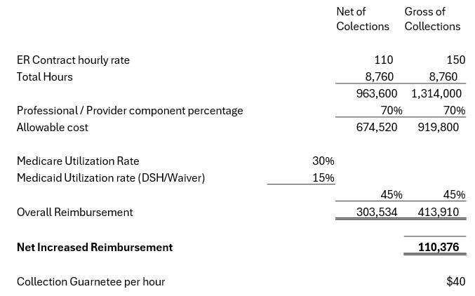
OPPORTUNITES
CAH’s have cost based reimbursement for Medicare patients, and there is enhanced reimbursement opportunity for professional services, including Emergency Services.
    CAH’s are not subject to limitations based on reasonable compensation equivalents RCE’s for certain specialties.
    Utilizing a gross contract, with a net collection guarantee, will net the same cash flow for the service but will achieve a higher net reimbursement to the hospital.
Notes:
BRENT

Slide 43

Questions?
Notes:
Update for Ft Worth?

