Slide 1
CFO Bootcamp
June 18, 2025

Slide 2

AGENDA
Supplemental Funding (DSH/UC) Update
  Detailed “Walk-through” the UC / DSH Payment Process
  How does the Cost Report Impact this area?
  Common Pitfalls and Best Practices
Medicare Advantage (MA)
  Why/How is MA different

Slide 3
What every Rural Hospital CFO Needs to Know relative to DSH/UC

Slide 4
DSH & UC Overview
Disproportionate Share Hospital (DSH):
  Federal program to help hospitals that serve a large number of Medicaid and uninsured patients
Uncompensated Care (UC):
  Part of Texas Medicaid 1115 Waiver program
  Provides supplemental payments for uncompensated costs of care

Slide 5
State DSH Proposed Rule Amendment – NOW FINAL
Will Deem ALL Rural Hospitals eligible for DSH
Will Exempt ALL Rural Hospitals from the trauma system COP
What Does This Mean?
  Must meet all other federal conditions of participation (COP) and eligibility requirements (ie. 1% MIUR (Medicaid Inpatient Utilization Rate – includes traditional Medicaid and Medicaid MCO) and 2-physician requirement)
  Exempt from 2-physician requirement if your hospital was open as of 12/22/1987 and not offering non-emergent OB services
  Trauma Designation not an issue any longer
Able to apply for DSH starting with DY 14 (2025) application
DSH Anticipated IGT/Payment file released on June 10th
  IGT July 1st → payment 30 days later (no IGT for private facilities)

Slide 6
The DSH/UC Application
a.k.a. the DSH/UC Tool
Combines application for both the DSH and UC programs
  Schedules 1-3 = UC Calculations
  Schedule 4 = DSH Calculations
Uses 2-year-old data to apply for future DSH/UC funding; based on federal fiscal year ends.
  Ex: For 2025 DSH/UC application:
    DSH Program year/UC Demonstration year = 10/1/24 - 9/30/25
    Data Year used as basis for the application = 10/1/22 - 9/30/23
Application historically sent out by the HHSC to Hospitals around mid-October; due mid to late November

Slide 7
Application Process - DSH
Data relative to discharge dates
Key Components:
  Medicaid inpatient days
  Low-income utilization rate
  Financial data from hospital cost report

Slide 8
Application Process - UC
Data relative to write-off dates
Key Components:
  Uninsured charity care costs
    Requires proper classification of charity care vs bad debt
  Medicaid shortfall amounts
    Medicaid costs – Medicaid Payments
  Financial data from hospital cost report

Slide 9
Audit Process - DSH
Conducted by Myers & Stauffer (contracted by HHSC)
Occurs every spring → typically in March
Occurs almost 3 years after the application
Validates:
  Medicaid Days
  Uninsured Costs
  Verifies compliance with DSH regulations

Slide 10
Audit Process - UC
Conducted by Myers & Stauffer (contracted by HHSC)
Occurs every spring → typically in June
Occurs almost 3 years after the application
Validates:
  Uninsured costs
  Medicaid costs
  Reconciliation to cost report

Slide 11
APPLICATION VS AUDIT
Aspect | Application | Audit
Purpose | Determine funding eligibility | Validate accuracy & compliance
Timing | Annually | 2–3 years after
Submitter | Hospital CFOs/Consultants | External auditors (review data)
Outcome | Determines payments | May result in recoupments
Documentation | 2-year-old data + adjustments | Source-level validation

Slide 12
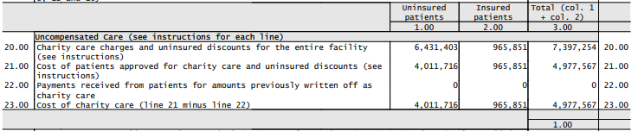
From Operations to Cost Report
FY 6/30/2020

Slide 13
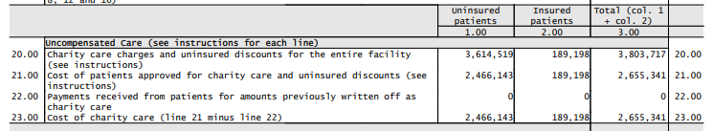
From Operations to Cost Report
FY 6/30/2021

Slide 14
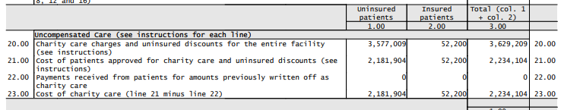
From Operations to Cost Report
FY 6/30/2022

Slide 15
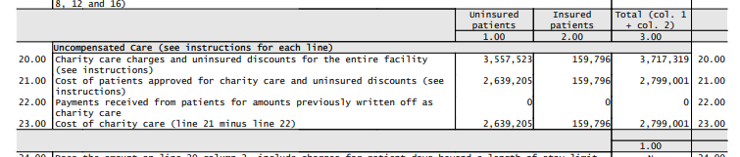
From Operations to Cost Report
FY 6/30/2023

Slide 16
From Operations to Cost Report
-What about our Days?-
FY 2020 – 1,162 → Per Diem 4,554.66
FY 2021 – 1,682 → Per Diem 4,494.42
FY 2022 – 1,893 → Per Diem 3,636.88
FY 2023 – 1,268 → Per Diem 7,501.14
This information found using Worksheet S-3 and Worksheet D-1

Slide 17
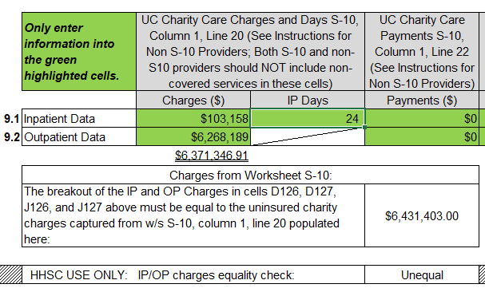
From Cost Report to App – DY 11

Slide 18
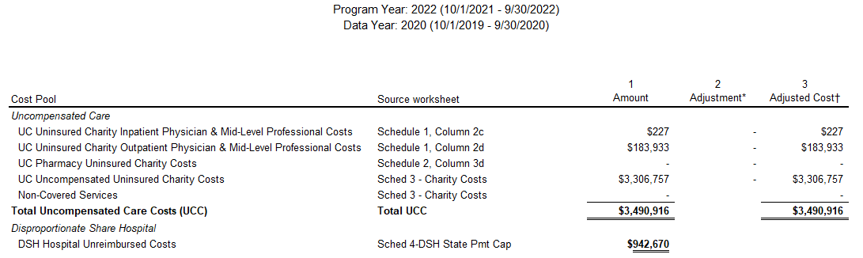
From Cost Report to App – DY 11

Slide 19
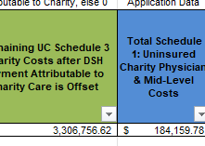
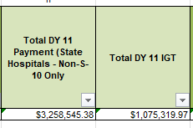
From Application to Payment – DY 11

Slide 20
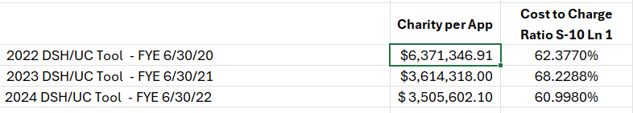
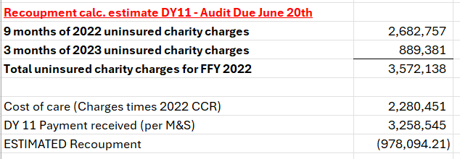
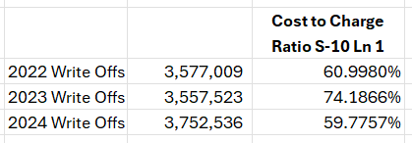
From DSH/UC App to Audit
DY 11 – FFY 2022

Slide 21
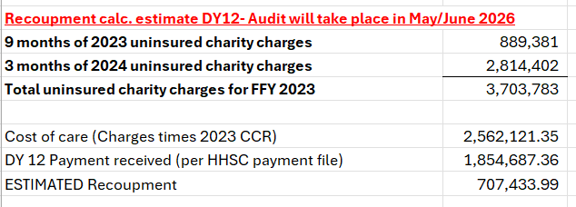
From DSH/UC App to Audit
DY 12 – FFY 2023

Slide 22
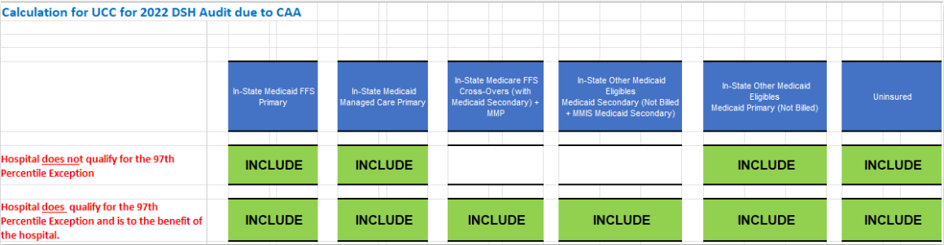
97th Percentile – Audit Impact
Federal FY 2022 (DY 11) is first year of impact
Previously a hospital’s DSH hospital specific limit (HSL) included costs and payments for all Medicaid and uninsured
Under this rule, Medicaid dual-eligible and unbilled Other Medicaid Secondary (OME) will NO LONGER be included relative to costs and payments unless the 97th percentile exception is met (we only have 2 hospitals we work with that meet this exception)

Slide 23
Common Pitfalls
Over-reporting of charity costs
Under-reporting of charity costs
Incomplete documentation of uninsured status
Misclassifying bad debt
Inconsistent data between cost report S-10 and application
  Be sure the cost report is the most recent (ex. Amended/Re-opening)
Loss of data during a conversion
Not reviewing the 404 Report Medicaid Claims Data from HHSC at time of DSH/UC application → used in future
Know Your Trend

Slide 24
Best Practices
Maintain strong internal documentation
  Data integrity is a must at all times
Train staff on Medicaid eligibility vs Charity vs Bad Debt
  Make sure they know and use the proper transaction codes
    What about non-covered services, & terminated coverage?
    What about an out of network situation?
Estimate and conduct pre-audit reviews/forecasts
  Know your costs and adjust accordingly throughout the year
  Know duplication costs between DSH and UC
Implement policy changes from audit findings, if necessary

Slide 25
What Qualifies as a Medicaid Day?
DSH/UC Specific
Patient was eligible for Medicaid on the date of service
The patient was admitted and remained past midnight
  An inpatient day – not observation or ER

Slide 26
What does NOT Qualify?
DSH/UC Specific
Patients pending Medicaid eligibility and later denied
Dual-eligible Medicare/Medicaid days where no day is assigned
Emergency-only Medicaid unless a full IP stay was covered

Slide 27
Special Cases
Case | Include? | Notes
Medicaid Managed Care | ✅ | If enrollment & eligibility are documented
Dual Eligibles | ⚠️ | Only if Medicaid pays for inpatient care (not just Part B crossover)
Retroactive Eligibility | ✅ | If patient is retroactively approved for Medicaid for that stay
Out-of-State Medicaid | ✅ | Must be Title XIX-equivalent and documented

Slide 28
What every Rural Hospital CFO Needs to Know relative to Medicare (dis)Advantage

Slide 29
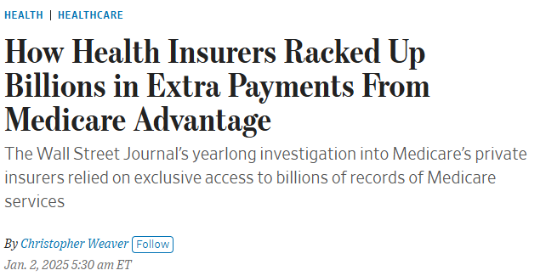
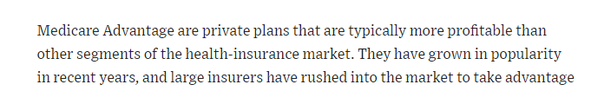
RECENT WSJ NEWS
Notes:
Paragon Health Institute Report

Slide 30
Medicare (Dis)-Advantage
Impact on Rural Healthcares
What’s the Problem w Advantage Plans?
  Simply said – many of these MA plans do not pay what Traditional Medicare pays,.
    This includes CAH and is amplified under cost-based payment methodology.
    No bad debt payment on many contracts
    Some pay Swing Bed at RUGS rate and not CAH rate, and those that pay CAH rate, the contract is difficult.
      If it is quoted as nursing home rate, that means RUG rate
    Traditional Medicare Pays CAH at cost-based rates. Medicare Adv. negotiate their own payment rates and may not offer rates equivalent to Trad. Medicare.
Notes:
Watch Contract language – pull RAs and look at payment against TM

Slide 31
Medicare (Dis)-Advantage
Impact on Rural Healthcares
What’s the Problem w Advantage Plans?
  Traditional Medicare (TM) Pays an average of 82% of Hospital cost on Medicare patients (AHA, 2022 study).
  Medicare Advantage pays an average of 88% of the amount TM pays, or 72% of Cost, yet receives approx. 104% of the funding that traditional Medicare would have spent on these beneficiaries. (AHA, 2022 study)
  Hospitals in highest MA transition states are the most impacted.
      Utah and Dakotas still have the lowest transition rate to MA and also have the least number of hospitals operating in negative margins, per capita.
      Michigan has the highest transition rate at 63% of Medicare being Adv.
Notes:
Pre-auth language

Slide 32
Medicare (Dis)-Advantage
Impact on Rural Healthcares
Confusing Contract terminology and Terms of Payment
Enhanced Medical Claims Review and Claim Rejection / Denials
Claims denials or delayed approval
Delay in Rate Adjustment (especially with Rate Increases) and no settlement process.

Slide 33
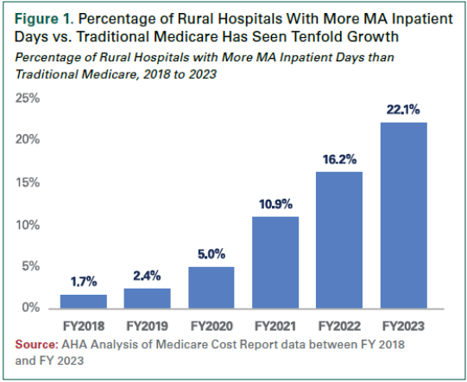
Medicare Advantage
Growth of Medicare MA Market in Rural Hospitals
Notes:
Many MA plans have reconsidered the prior auth process – good news.

Slide 34
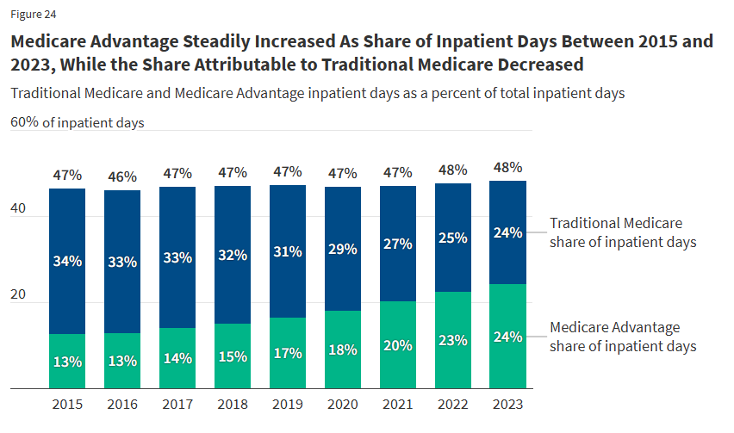
COMBATING ADVANTAGE
Source: KFF (Kaiser Family Foundation) Healthcare Research

Slide 35
Medicare Advantage
Growth of Medicare MA Market in Rural Hospitals
Population Statistics
In 2018 - 2020 – approx. 63M Americans were enrolled in Medicare
  Approx 15-20% of those are in Rural US areas – 9.5M rural MC benefic.
    Approx. 1,214,222 or about 12.75% of Medicare was enrolled in MA
  In 2024 – approx. 67M Americans were enrolled in Medicare
    Approx 10% of those are in Rural areas – 6.5M rural MC Benefic.
      Approx. 3.4M or about 51% of Medicare is enrolled in MA
  In 2025 - Texas has 4.9M Medicare benefic. and 20% in rural areas – 980,000 rural
      Approx. 543,900 Texans enrolled in MA plan – 55.5% MA enrollees as of April 2025.
Notes:
Percentages
58.6M Americans on Medicare in 2020 – Rural has 20% of those (11.7M) - Percentage of MA in 2020 = 10.38% of MC – 1.2M rural in 2020.
67M in 2025 – Rural has 20% of those (13.4M) – Percentage of MA in 2025 – approx 50% nationwide – about 33M Americans enrolled in Adv plan in 2025. apprx 6.7M in rural 558% inc

Slide 36
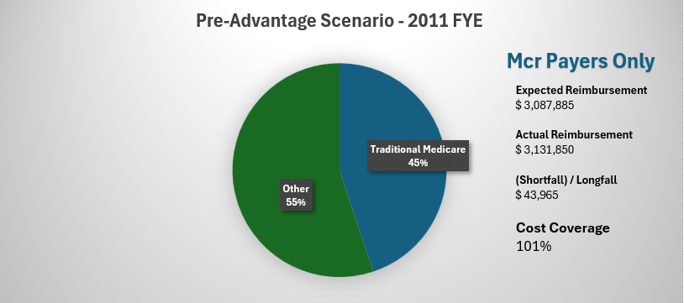
Medicare Advantage Comparative
Impact on Rural Healthcare – CAHs

Slide 37
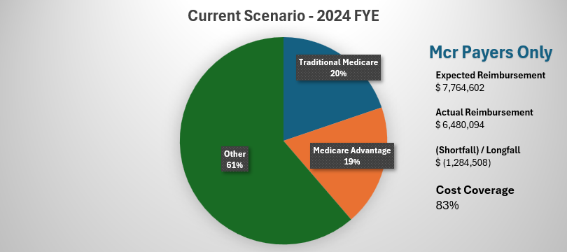
Medicare (Dis)-Advantage Comparative
Impact on Rural Healthcare – CAH s
  Overall, CAH hospitals reviewed to this point, we know that a large amount of short-fall is denied claims.
Notes:
Average over all hospitals is that about $306,000 appears to likely be related to claims denials. This is across IP, OP, and Sw Bed and some hospitals had much more, some much less.

Slide 38
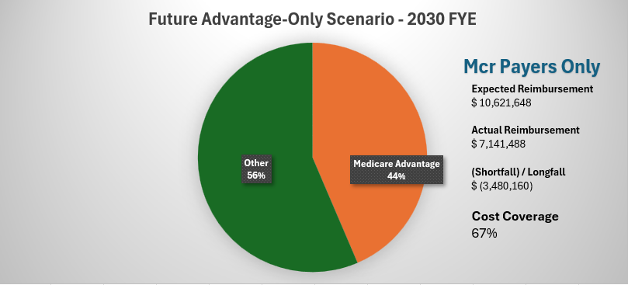
Medicare (Dis)-Advantage Comparative
Impact on Rural Healthcare – CAH

Slide 39
How does Medicare Advantage (MA) impact reimbursement in a CAH?
Inpatient Acute Care Reimbursement
Undercounting Medicare Cost – Medicare cost report methodology considers MA patient days as “commercial days” rather than Medicare days. This practice undercounts the overall Medicare cost and diminishes the value of cost-based reimbursement for traditional Medicare beneficiaries. (Center for Medicare Advocacy)
Medicare Adv plans typically require pre-authorization approval prior to covering certain services, particularly IP service areas.
Impact on Cost / Charge Ratio
Prior (Pre-)Authorizations lead to longer lengths of stay (more Adv days)
Impact to the State Supplemental Funding
Notes:
Deflated Medicare Cost – The underestimation of MA patient costs in the cost report can also result in an artificial deflation of overall cost, impacting areas like wage index, cost per diem, observation stay cost, and supplemental payment programs

Slide 40
How does Medicare Advantage (MA) impact reimbursement in a CAH?
Swing Bed reporting and Reimbursement
The Cost Report methodology considers MA patient days as ‘Commercial days: rather than Medicare days…., except in the area of swing-bed (emphasis added).
  Division of the days between Medicare and non-Medicare days for swing-bed services
  The cost report instructions stipulate that all ‘covered’ (paid) Medicare days – Trad. and MA. – be included into the cost per diem calculation.
  The cost report allows for exclude non-Medicare days into the certified (SNF) swing-bed days. We are allowed to exclude non-Medicare (Medicaid, self-pay, other) from the ‘bucket’ of total swing-beds.

Slide 41
How does Medicare Advantage impact reimbursement in a CAH?
Outpatient Procedure Reimbursement
  Impact to the Cost / Charge Ratio
  Pre-Authorization Process and addressing denied or rejected or delayed pre-auth determinations
  Cost Report handling to correct charge structure for denied and rejected claims
  Certification review and provisions for clinic to ensure Medicare Adv contracts match traditional Medicare
  Clinic Provisions and services – negotiated rates and concentration on payment rates for consistency or close to the amount paid by traditional Medicare claims (Fee schedule vs Cost)

Slide 42
How does Medicare Advantage impact reimbursement in a CAH?
Observation Stay Reimbursement
  Observation equivalent Days inclusion
  Pre-Authorization Process and addressing denied or rejected or delayed pre-authorization determinations – delayed payment on pre-auth can be a big deal!
  Impact to the Cost / Charge Ratio
  Instructions to the Cost Reporting forms- CMS 2552-10 Section 4005.1
    Observation – “Enter the total Observation bed days in column 8. Divide the total number of observation bed hours by 24 and round up to the nearest whole day.”

Slide 43
What do we know!!
Center for Medicare Advocacy –July 18, 2024
  “The Real Impact of Medicare Advantage…..”
MA Plans are funded approx. 22% more than what Medicare would have paid if MA enrollees were in traditional Medicare in 2024 alone. (paraphrased)
“Paradoxically, despite those overpayments, MA plans spend 9% less on Medicare services the FFS Medicare spends for comparable enrollees.”
The report also contest the idea that MA plans offer less expensive options for beneficiaries. The Center for Medicare Advocacy actually supports that the MA plan is the same cost or slightly more expensive than those beneficiaries in TM.
Notes:
Medicare = approx $65B.
MA funding is apprx $83B and they spend approx. $59.5B spent on medicare services. Difference of $23.5B

Slide 44
COMBATING ADVANTAGE
How do we change the tide back to traditional Medicare
Beckers cites that 15% of health systems have terminated Advantage, and that over 60% are looking at termination or limitation of plans.
Join your local state advocacy group in initiative to vocalize the short-fall

Slide 45
What can you do?
How can you get your population to switch back to traditional Medicare?
Educate
  As simple as brochures in the hospital, to
  A coordinated community education program.
Political issues with refusing advantage
  – Yes, you will have some, but would they rather have a tax increase?
Working on ideas with your local advocacy group.
Join them: Medicare Plan Essential Hospital Payment

Slide 46
Why do you need to continue to take Advantage?
You don’t
Modern healthcare has reported many rural hospitals dropping plans.
  It actually restarts negotiations
The plans are pushing back, suggesting legislation that mandates acceptance of plans and does not require network sufficiency.
  Network regulations are already being relaxed.

Slide 47
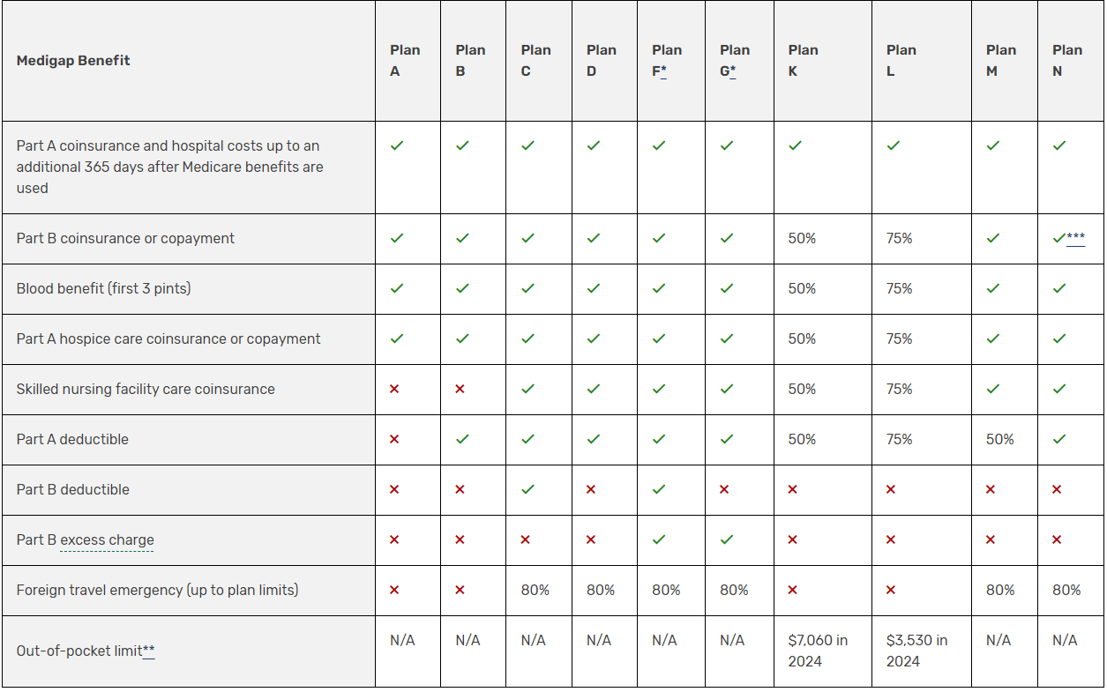
Medigap Plans

Slide 48
Supplement vs Advantage
CMS has made Supplements or MediGap more cumbersome to de-incentivize
  Require a separate decision on the Drug plan from the supplement
  Complex rules
  More confusing to the elderly population,
  Much less marketing towards Supplements.
    Follow the money
Overall cost to the patient is not very different, but the marketing is.
Marketing of the Advantage is much more aggressive
  “Give Back” plans under Advantage actually give the enrollee more Social Security payments, but then take it back with more co-pays. It’s a marketing tool.
  One Stop shopping
  Less upfront cost, more copay, LESS CARE
  Silver Sneakers and other small benefits
Advantage sounds great, until you need the care.

Slide 49
Medigap vs Advantage Comparison
 | TRS Plan | "G" Plan (Humana) | + Drug Plan (AARP) | Total Supplement
Premium | 135 per month | 108 per month | $54.20 per month
 | $1,620 | $1,296 | $650 | $1,946
Deductible | $400 | $240 | 0 | $240
CoPays | $560 | None
Drug Copays | $840 |  | $759 | $759
Mark Cuban Savings |  |  | ($230) | ($230)
 | $3,420 |  |  | $2,716

Slide 50
LEGISLATIVE SOLUTIONS
Current Legislation -
  Two Bills in Congress to address / assist with Medicare Advantage payment models
    One dealing with Payment level review – Pre-authorization.
      Texas Gold Card
    One dealing with increased level of price transparency in data for MA plans.
    None addressing improvement of payment criteria or accountability – including in the currently discussed H.R.1 (labelled the “Big Beautiful Bill”).
  MEDPAC did just issue a report to Congress in March
Notes:
Claims Denials and Peer Review is probably the largest vulnerability among small hospitals, bc of the time spent away from healthcare.
By Updated payment schedule from the MA, reference is the payment pricing schedules – what we used to call ‘pricers’. Alternatively, the timeliness reference for CAH is quickly turning around most recent CR rates and Interim rates.

Slide 51

Questions?
Notes:
Update for Ft Worth?

